Slide 1
Analytics and PowerBI

Slide 2
Agenda
Analytics
Introduction
Scenarios
Use cases
PowerBI
Introduction
Scenarios
Use cases

Slide 3
Analytics
Collecting and evaluating data that is collected
Step 1: Usually a lot of data is collected – but never evaluated
So: Collect the data and make it available to teachers etc
Step 2: take some historical data, feed it into machine learning and start making predictions about the future development of people based on the data

Slide 4
Students are the core of every institution of learning.
Notes:
The solution we are going to talk about is of top of mind as it focuses on student lifecycle and success management. Students are at the core of every institution. In this presentation, we’re going to answer 2 questions-
How should an educational institute manage its students lifecycle from prospecting to current students to alumni management. What does Microsoft offer in this space?
And secondly, what key metrics should be analyzed and shared to manage the success of students and institutions. What Microsoft technologies can help?

Slide 5
Successfully managing student lifecycles – from recruiting the right students to seeing them through as alumnus – is key to great learning outcomes.
Notes:
Imagine if you could resolve critical education challenges by arming stakeholders with the data they needed to generate insights, predict future trends and behaviors, and take proactive actions that improve outcomes.

Slide 6

Are you seizing on all the opportunities to help create the best results for current student and alumni success?
Are you taking advantage of the latest technology?
Do you, your staff, teachers and other educational influencers have all the analytical tools they need to get those results?
Do you have the meaningful and actionable data to make smart decisions that elevate your institution’s performance?
Are your enrollment efforts identifying the best student for your institution?
Notes:
Education is a complex business. Stakeholders in K12 and higher ed—from provosts, superintendents, and principals to teachers, administrative staff, and policy makers—face a myriad of challenges spanning different areas.
Are you identifying the best students?
Do you have the latest technology available to your staff and students?
Are you creating the best results for your current students and alumni success?
Do you have the right analytical tools and data for your educators and staff to drive results?
Can you elevate your institution’s performance by making smart, data-driven decisions?

Slide 7
The Microsoft platforms can open up new possibilities to help your institutions attract the best students, create optimum student outcomes - on both learning and career paths - and elevate your institutional performance.
Notes:
Let us show you how the Microsoft platforms can open up new possibilities to help your institutions attract the best students, create optimum student outcomes - on both learning and career paths - and elevate your institutional performance.

Slide 8
Student Recruitment & Enrollment

Slide 9
The goal is to attract the right students and effectively manage the admissions and enrollment process so you don’t miss a prospective student.
Notes:
Today’s students are evolving quickly, their way of finding information about universities and colleges is changing rapidly with vast information available at their fingertips on the internet and social media forums.

Slide 10
Higher education institutions must adapt to the modern student journey.
Recruit
Enroll
Retain
Notes:
There is a greater need today to attract more prospective students and recruit the brightest. Higher competition and options for your prospective students will require a greater effort on your institutions part. Converting those prospects to students, retaining them as alumni and future donors will create long term value for your institution.
And therefore, institutions must learn to adapt to the new student journey to attract the right students and effectively manage the admissions process. For that, you need to give your team tools to process applications efficiently, make vital business decisions and deliver seamless experience to the applicant.

Slide 11
That journey is dominated by mobility and social media, and the onus is on institutions to attract these students during this new mobile age. Institutions must embrace social media and mobility to effectively attract and engage students.
Notes:
What is interesting is prospective customers are 70% through the buying process before they even speak with the institution. In order to reach this audience, you have to be where they are by marketing relevant and engaging campaigns, events and information across both traditional and social channels

Slide 12
We can help you understand what students are saying
Campaign Monitoring
Measure the effectiveness of the universities marketing campaigns in real time.
Brand sentiment analysis
Gain insight and learn what students, alums, and parents really think and feel about your university across the globe.
Competitive Intelligence
See how you measure up against other institutions. Identify differentiators, strengths, and weaknesses.
Notes:
Microsoft can help you understand what these students are saying. You can do this with Dynamics 365 with campaign monitoring, brand sentiment analysis, and competitive intelligence.
With actionable and easy access to data, you can deliver a rich experience throughout the student journey. Your current students will be future advocates and generate a source of revenue, so invest in them from the start.

Slide 13
We can help you with your student interactions
Visit School Website & Research Online
Request School Information
Request a Campus Visit
Submit an Application for Enrollment
Notes:
Typical student engagement model begins with students researching online and visiting the school’s website. This follows request for more information and/or a school visit. Based on their research thus far, prospective students then decides to apply. At that point, a school has had various touch points and should track this information.

Slide 14
And help manage everything using Dynamics CRM
Notes:
Microsoft can help you with tracking this data all in one place using Dynamics CRM. A simple process flow would look like this -
You receive the application, check whether it meets requirements, route it to the approval board, and then approve or deny it. Apart from providing a simple process for students and administration, the information can benefit the school in pro-actively making changes and evolving with their customers.

Slide 15

Grand Canyon University
Situation: Modern education happens in the classroom, online, and in blended environments. These expanded formats created a new level of complexity for students and educators at Grand Canyon University.
Solution: Utilizing Microsoft Dynamics CRM, the University was able to modernize, allowing them to anticipate and fulfil student needs.
Read More
Notes:
Here’s an example of the Grand Canyon University. Given universitites now are engaging students both in classroom and online, Grand Canyon University had a new level of complexity for their students and educators.
The school utilized Microsoft’s Dynamics CRM platform to better capture student information, regardless of whether the learning was taking place online or in-person. This flexibility allowed the university to make quicker changes over time while still using expanded formats of teaching.
https://customers.microsoft.com/Pages/CustomerStory.aspx?recid=21108

Slide 16

Education Analytics

Slide 17
So, once you have the best students, how do you help them succeed?

Slide 18

Imagine if you could…
Proactively identify students needing additional support
Provide students the means to effectively plan, connect, collaborate, research, and gain insight from others
Resolve critical education challenges faced in your schools using data
Notes:
<Start with the text on slide>
At Microsoft, we believe everyone should have easy access to the data they need to make informed decisions and take proactive actions. Currently, only about 10% of an institution’s stakeholders have access or can make use of available data.
The challenge is that accessing and analyzing data can be very complex and daunting.
Each audience needs varying degrees and types of insights and analytics, and there are different ways that they would use that data. For example, teachers for improving student learning and teaching tactics; superintendents to make program decisions, EDU policy makers to make budgetary and other policy-level decisions.
However, how can your teachers, superintendents, provosts, line-of-business managers, and other stakeholders easily access the data they need and get it into the right format so that they can analyze and act on it?

Slide 19
The goal is to use the power of analytics to empower student success.
Freshman to Senior Year
Graduation
Dedicated Alumnus
Notes:
Power of analytics can help with:
Personalizing learning based on student performance by providing data to educators to intervene on a regular and timely basis.
Tracking students performance to make sure they graduate on time
Use information about alumni to maintain the relationship over long term to build loyalty and professional engagement

Slide 20
What are the advantages of education analytics?
Students get feedback on their pattern of performance in learning systems
Instructors get detailed reports on all students, as well as relative effectiveness of lessons and content, freeing them from low-order assessments to focus on more complex feedback
Content Designers and Curriculum Managers get data on content usage and relationships between content and learning
School System Leaders get data across campuses year to year
School Leaders get student progress data, teacher effectiveness data, and school level outcomes.
Notes:
By providing the tools to make data collection, predictive analysis, reporting, and sharing easily and readily available to you and your stakeholders, we help your provosts, superintendents, teachers, and others gain insights, understand future trends, make proactive adjustments, put new ideas into action, and get the outcomes you want. As you can see on this slide, with analytics, students get feedback on their pattern of performance and instructors are able to better engage by using detailed reports on all their students.
A difficult area in the past has been getting feedback on class content, and analytics allows you to do that with access to data on content usage and understanding the relationship between content and learning.

Slide 21






Cortana Analytics Suite: Transform Data to Intelligent Action
Information Management
Big Data Stores
Machine Learning and Analytics
Dashboards and Visualizations
SIS
Power BI
Azure
Data Factory
Azure
Machine Learning
Personal Digital Assistant
Azure
Data Lake
Cortana
People
LMS
Azure
Data Catalog
Azure
HDInsight (Hadoop)
Perceptual Intelligence
Azure
SQL Data Warehouse
Face, vision
Speech, text
Azure
Event Hub
Azure
Stream Analytics
Business Scenarios
Sensors and devices
Recommendations,
customer churn,
forecasting, etc.
Automated Systems
DATA
INTELLIGENCE
ACTION
Notes:
How does it work?
We help you by ensuring that your customers can discover the right information, analyze it using the right tools, and share it with the right people to make the right strategic decisions.
Identify: Education institution identifies what are their complex challenges and key questions they would like to answer, such as how to lower dropout rates, measure teacher performance, etc.
Inventory: Take inventory of the current data to figure out what the education institution currently tracks and what systems are used. This might require database experts to clean and compile the data into an appropriate format.
Analyze: Involve a data scientist in-house or with a Microsoft Partner to identify what queries need to be set up to update the data and what algorithm should be used with Advanced Analytics tools such as Azure Machine Learning. Usually a one-time task for the initial set up that is refreshed daily and can be iterated to improve data outcomes over time.
Solve: Create a visual dashboard in PowerBI that provides results on the key questions and can be personalized in different ways according to the stakeholders accessing it. Getting insights isn’t just for the skilled analyst. BI analysis is simply another routine aspect of the job for all professionals. Microsoft provides the powerful visualization tools with the intuitive interface to get the right information, analyze data, and visualize it to find the trends and insights to drive your business. With personalized insights, your users can mine and examine data through advanced analysis tools that they are already familiar and comfortable with. And business professionals should be able to visually display the data in a way that is relevant to their jobs. This makes getting insights fast and easy with a self-service approach to insights. This allows your end users to form theories, analyze information, and refine them as they visualize the information. Action: Finally, when you take action and operationalize the insights that you have uncovered, you address the collaborative needs of an insights solution. Critical business decisions involve multiple stakeholders. Teams, not just individuals, assess situations—so give your workforce the ability to make team-based decisions easily. Workers can share information about why events are unfolding the way they are. This helps provide a business context for their findings. Business professionals share their findings and discuss the meaning and possible options for improving business performance. Business executives and everyone else can access information from any device, which allows them to drill into data and make "in-the-moment" business decisions. With these capabilities, you can take advantage of the collective intelligence of the organization to adjust strategy and programs, and to improve results.

Slide 22
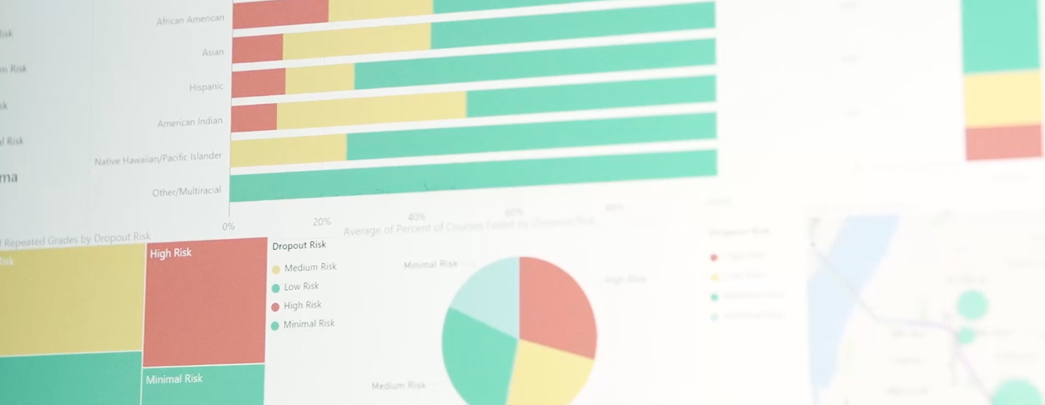
Tacoma Public Schools
Situation: A 2007 national study dubbed the 30,000-student Tacoma Public School district’s five high schools “dropout factories,” where many freshmen never made it to graduation.
Solution: Using cloud analytics, the school began predicting student dropout risks. Graduation rates jumped from 55 to 82.6% by 2016 & today the district is recognized nationally for its educational achievements.
Read More
Notes:
https://customers.microsoft.com/Pages/CustomerStory.aspx?recid=20703

Slide 23
The opportunity is bigger than you may think
Diverse data
$1.6T
New analytics
@
How?
Speed
data dividend available to businesses that embrace data over the next four years
More people
Data source: Microsoft and IDC, April 2014
Notes:
Key Points:
Companies that make best use of data and analytics investments stand to capture more value compared to companies that do not
Data is the new currency—the formula is relatively simple as to how we get our returns on data
Talk Track:
If data is the new competitive advantage for business, we want to get granular and specific on how companies can derive business value.
IDC explored the impact of data on business. After surveying more than 2,000 companies, IDC found that there are two categories of businesses: organizations that have taken a leadership position when it comes to data; and those that are not making best use of data. We learned that the leaders—those companies that embraced data—derived significantly more dividends from those investments in data—from increased revenue, improved productivity, and reduced costs.
There is a unique formula that drives this notion of data dividends, or return on data. Data-driven companies focus on several areas:
Capturing diverse data: You can no longer just think about what to do with traditional data types. You need to be open to and capable of collecting a wide array of data—including new data types.
Utilize new analytics: Logical data warehouses are no longer going to extract and transform new data types. You need to explore new analytical capabilities that are suited to new data types and real-time decision making needs.
Deliver to more people: To unlock insights, you need to democratize your data across the organization.
Uncover real-time insights: With the rise of the Internet of Things, and the instrumentation of just about everything, the ability to provide real-time visibility across lines of business represents a big value opportunity.
At the worldwide level, leaders will capture $1.6 trillion more in value from their data and analytics investments over the next four years compared to companies that don’t. This represents a 6 percent higher data dividend for leaders—an opportunity that exists for any individual organization looking to maximize its return on data assets and reap ongoing data dividends.
This means that data really is a new currency of the twenty-first century business economy.

Slide 24
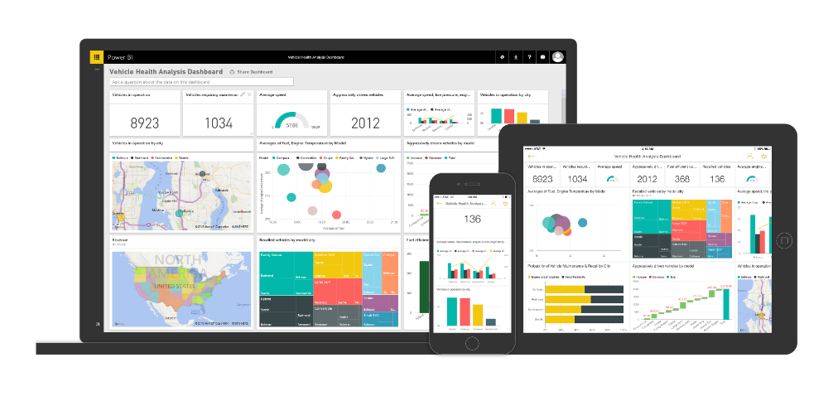














Power BI: experience your data Any data, any way, anywhere
Microsoft Cloud
INTELLIGENCE
Stream Analytics
Machine Learning
Non-Microsoft Cloud
5,000,000+ subscribers 210+ countries
200,000+ organizations
Statistical Analysis
On-premise data
Intelligent Apps
Notes:
Power BI is a cloud-based business analytics service that enables anyone to visualize and analyze data with greater speed, efficiency, and understanding. It connects users to a broad range of live data through easy-to-use dashboards, provides interactive reports, and delivers compelling visualizations that bring data to life.
Through of the course of the preview over 90,000 companies, cross 185 countries have used Power BI. That is a decade's worth of growth in last generation business intelligence where I have to go get software, install software, get servers, get analysts involved, get all sorts of people involved before anyone got any value, that's a long road from "I want to do it" to "I've done it". With Power BI, this is an enormous user population of people that are now connected with data in a way that was either previously very difficult or for many impossible.
Power BI in many ways is a connector between people and the power of the Microsoft Data Platform including data that lives in our cloud, other peoples clouds, or your on-premise systems and also processed by this wide variety of intelligence analytical capabilities that we have - statistical analysis, machine learning, building custom application - all of this technology and the value of converting data into intelligence flows through Power BI.

Slide 25
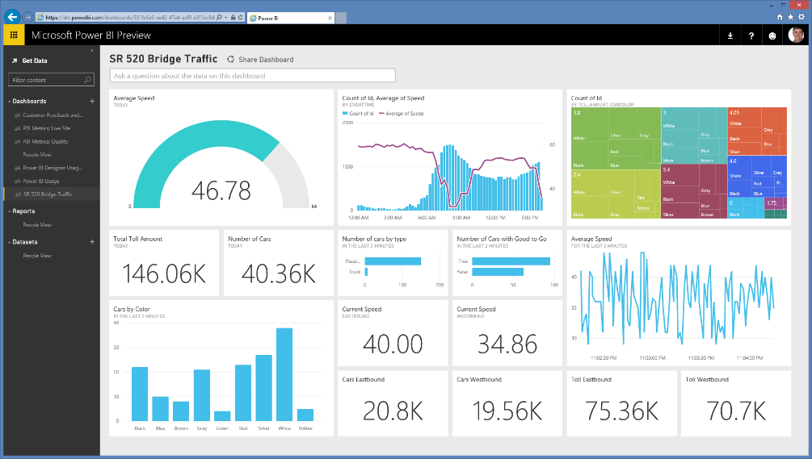
Live dashboards & reports
Live dashboards provide a 360º view of your business
Track your data in real-time with support for streaming data
Drill through to underlying reports to explore in more detail
Pin new visualizations and KPIs to monitor performance
146.03K
145.96K
146.06K
145.84K
39.99K
40.08K
38.84K
40.33K
Notes:
Power BI dashboards
With updates to Power BI customers can now see all their data through a single pane of glass. Live Power BI dashboards show visualizations and KPIs from data that reside both on-premises and in the cloud, providing a consolidated view across their business regardless of where their data lives.
You can then explore their data further by drilling through the dashboard into the underlying reports, discovering new insights that they can pin back to the dashboard to monitor performance going forward.

Slide 26

Mobile apps
Native apps for iPad, iPhone, Android and Windows devices
Receive alerts to important changes in your data
Share and collaborate with colleagues and take action
Notes:
Cross-platform, native mobile apps. In addition to its rich Web client, there are native Windows, iPhone, iPad and Android apps that keep mobile users connected with their data, wherever they may be.

Slide 27







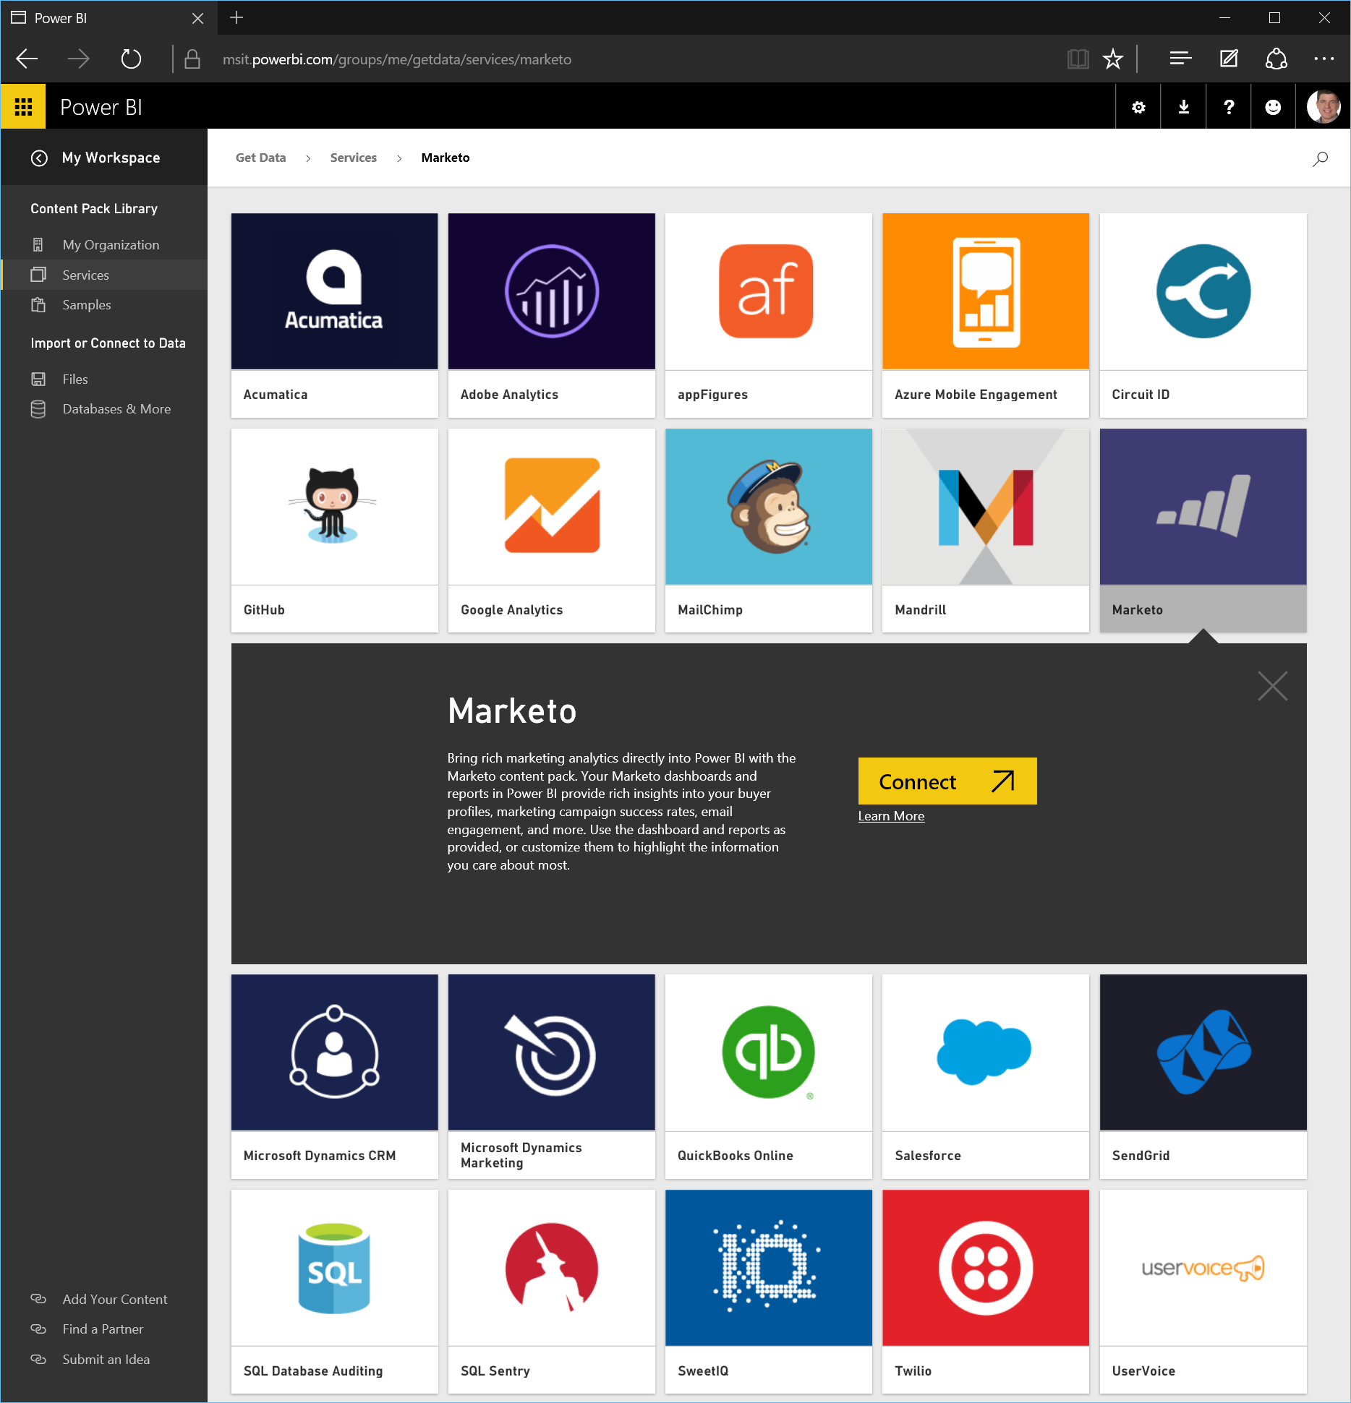




















Get started quickly
Pre-built solutions include dashboards, reports, and data models available out-of-the-box for SaaS services or built by your organization
Dynamics Marketing
Azure Audit
Logs
Microsoft Dynamics NAV
Azure Mobile
Engagement
Application
Insights
SQL Database
Auditing
Notes:
Get started quickly. While even some legacy business intelligence solutions provided “connectors” for SaaS services, Power BI takes it a few steps further by providing complete, “out of the box” content packs for Power BI for these services. When a Power BI user connects to their Google Analytics data, for example, they get a curated collection of dashboards and reports that continuously update with the latest data from the user’s Google Analytics account. We are effectively acting as a team of IT, BI and business analysis professionals on behalf of the user. The result is that more people can connect with and gain insight from their data, faster and more simply than ever before. What used to take days, weeks, months or even years of complex coordinated work now happens quickly.

Slide 28
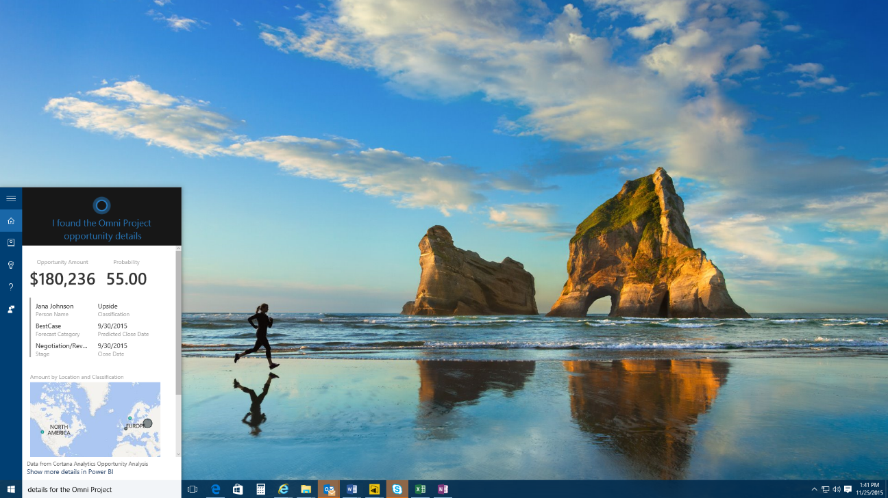
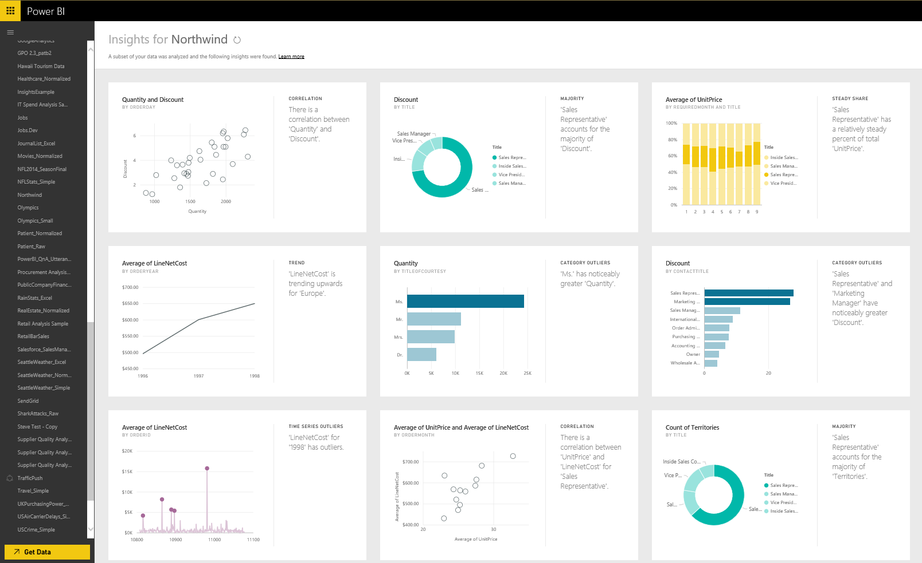
Experience your data in new ways
“Hey Cortana, show me my sales opportunity”
Natural language query—ask questions of your data more naturally
Cortana integration—allows you to access your data from Windows 10
Quick insights—auto discover patterns and insights in your data
Notes:
Natural Language Interface - With Power BI we continue to find new ways to simplify how people analyze and gain insight from data, providing industry leading features such as natural language query. Natural language query provides users with an easier way to interact with their data, allowing them to type questions of their data and receive answers in the form of live visualizations. Power BI integration with Cortana allows you to now ask these question directly from Cortana and to have answers from your Power BI data surfaced to you by Cortana. These data driven answers can range from simple numeric values (“revenue for the last quarter”), charts (“revenue over time”), maps (“revenue by region”) or data represented through any of the other Power BI data visualizations. Combined with the Cortana Analytics suite, this opens up amazing new opportunities to use Cortana to enable your business, and your customers' businesses, to get things done in more helpful, proactive, and natural ways.
Quick Insights - providing a new ways to help users find hidden insights in their data. The new Quick Insights feature allows users to automatically scan and detect patterns and trends in the data that they publish to Power BI. Through a partnership with Microsoft Research, the Quick Insights feature uses a growing list of algorithms to automatically discover and visualize correlations, outliers, trends, seasonality, change points in trends, and other factors in your data in seconds.

Slide 29
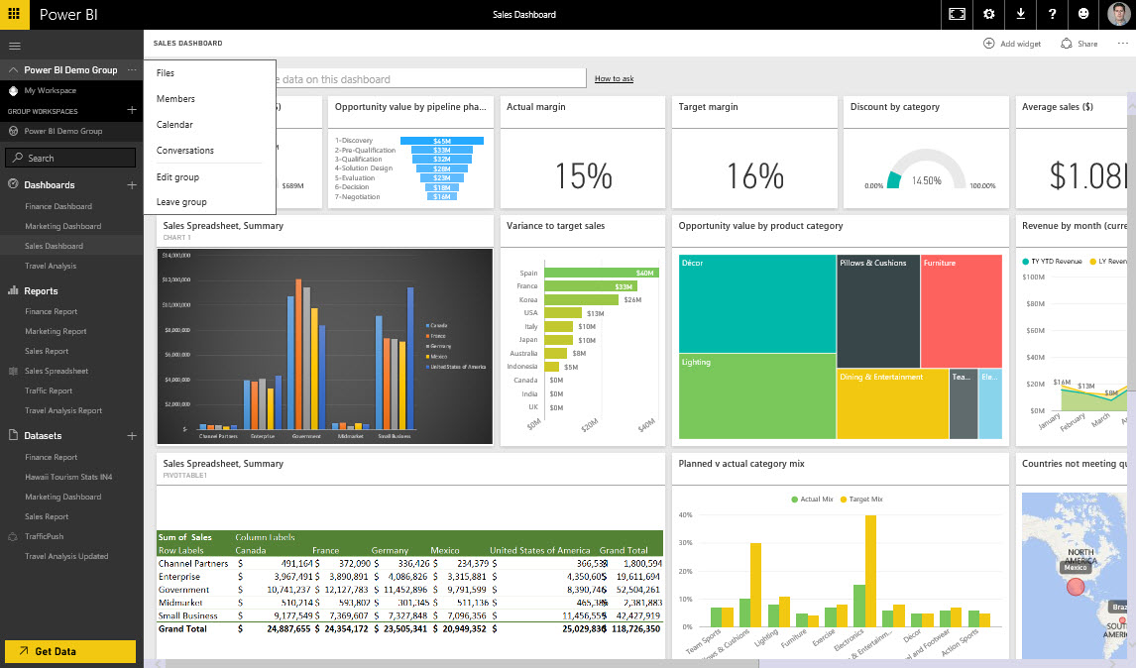
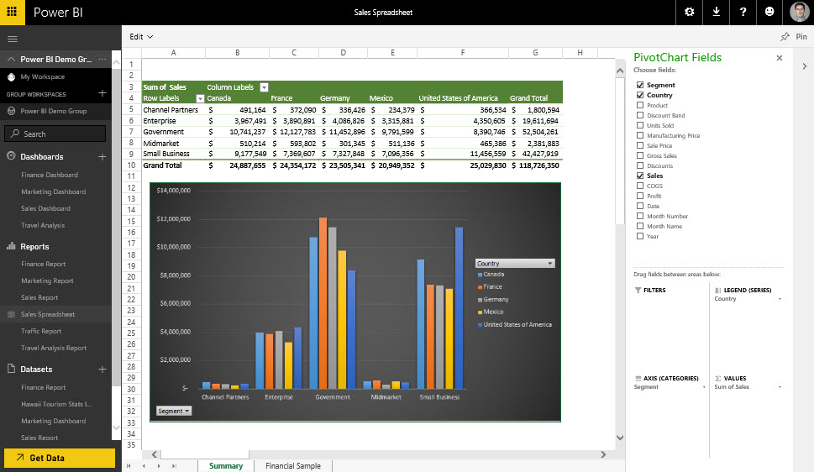
Seamless integration with Office 365
Team collaboration through support for Office 365 Groups
Seamless navigation to other workloads in Office 365
Use Excel data and pin live charts to your Power BI dashboards
View Excel spreadsheets through support for Excel Online
Notes:
Team collaboration is enhanced with Power BI integrated with Office 365. Create Office 365 Groups so that only the members of the group can view and edit specific reports and dashboards. Navigate from Power BI to any of the other Office 365 workloads as you view conversations, documents, notes etc all in the context of your work group.
Take your Excel data to the next level with Power BI. Pin live Excel charts and ranges to a Power BI Dashboard or share your spreadsheets to Power BI and view them through Excel Online.

Slide 30
Demo

Slide 31
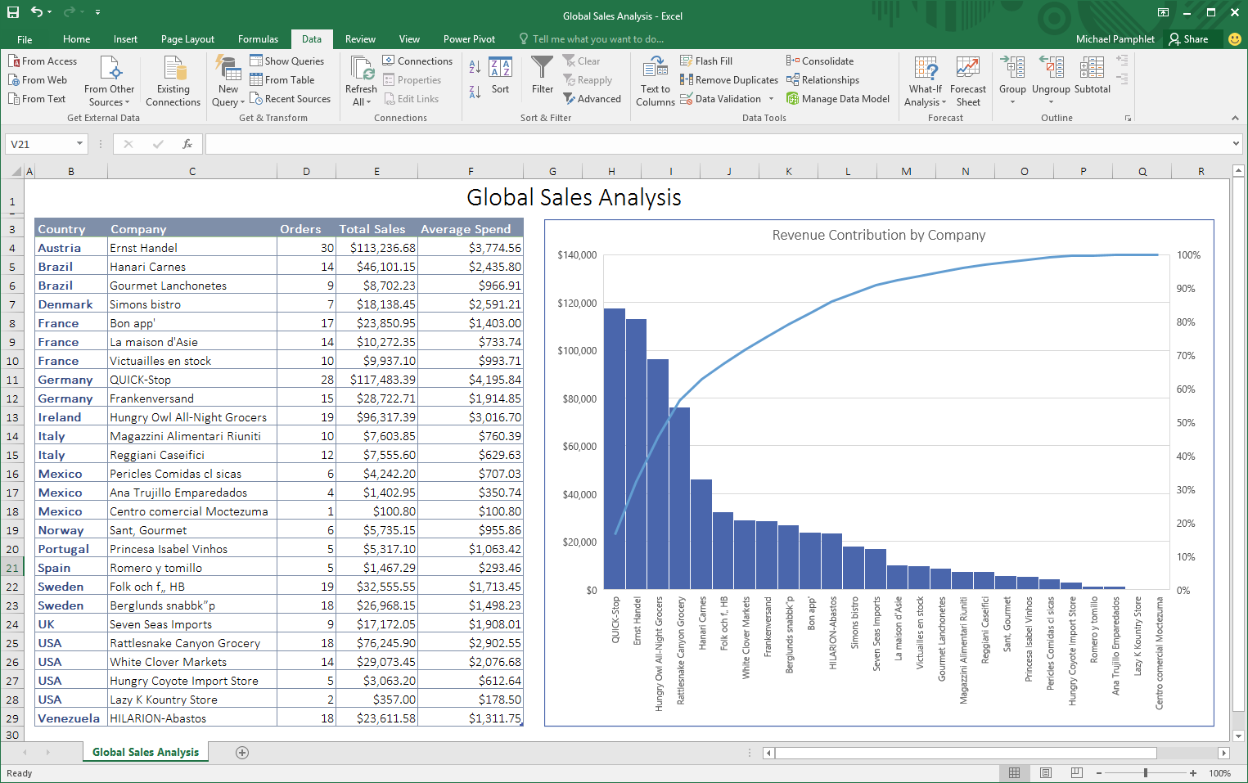
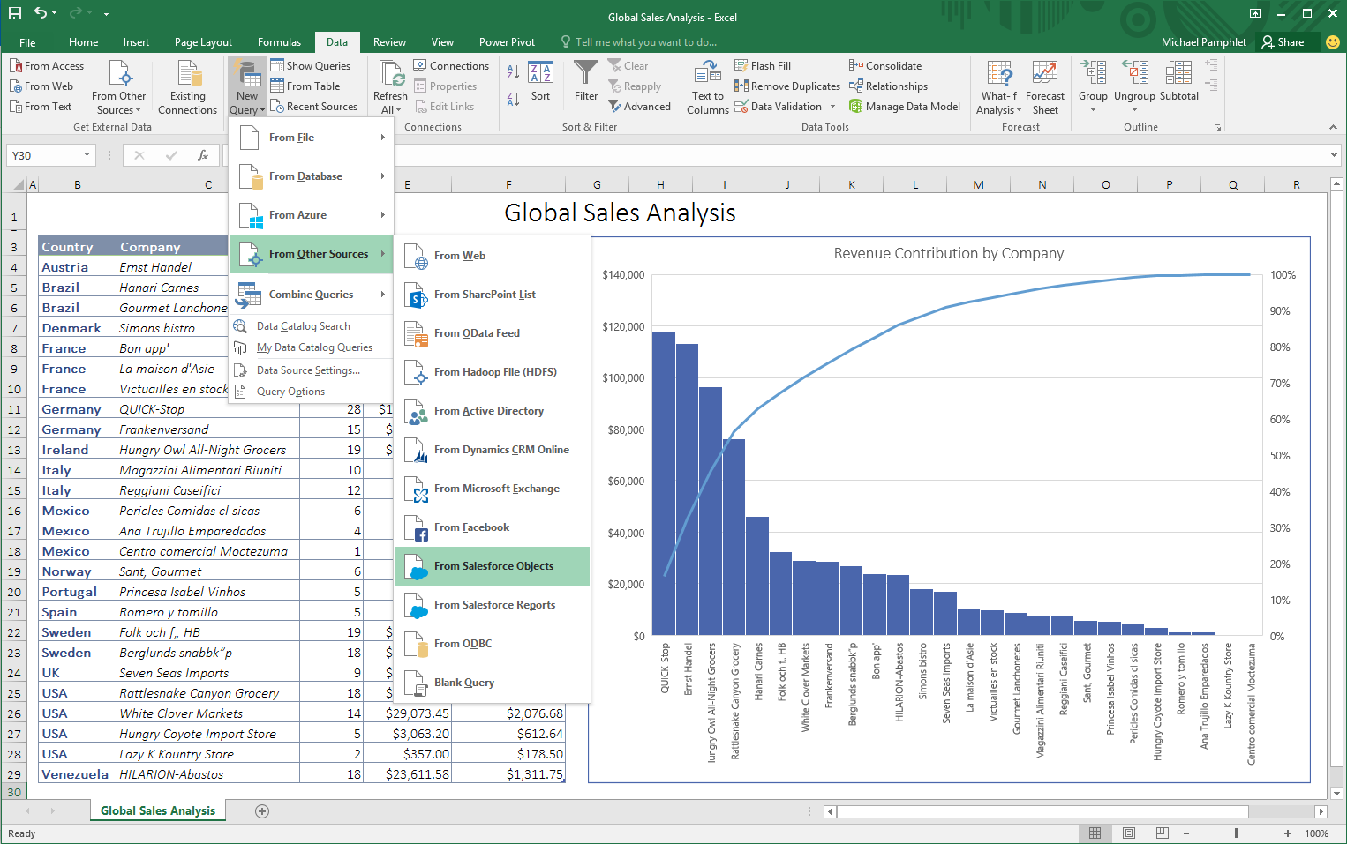
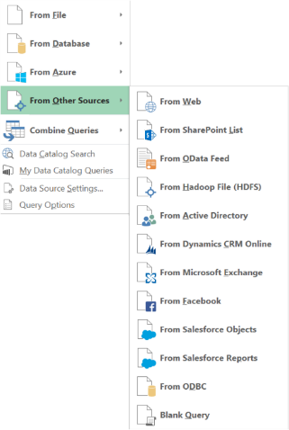
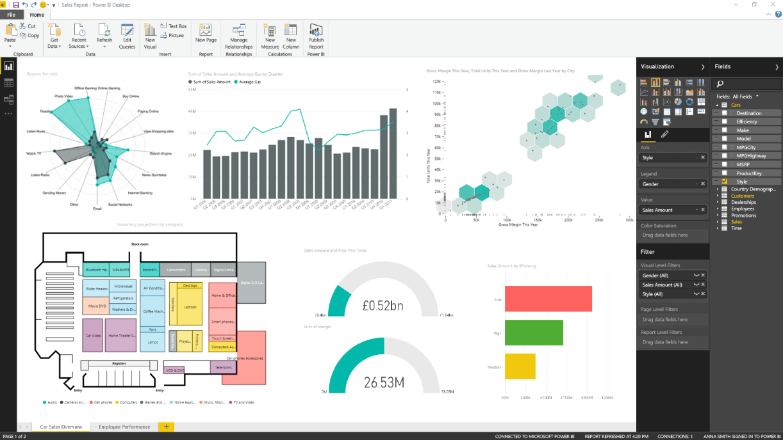
Powerful self-service analysis
Excel
Ad-hoc analysis for blending structured and unstructured data together for analysis in familiar spreadsheets
Power BI Desktop
Visual drag-and-drop data exploration and interactive reporting on a freeform canvas
Notes:
Excel as the world’s most flexible and widely used data analysis tool, providing familiarity and flexibility when working with data in the context of the Excel grid and native charts and graphs. Excel uniquely allows users to perform ad-hoc analysis, blending structured and unstructured data together for analysis in the familiar Excel environment.
We also introduce Power BI Desktop an a tool for business analysis to create visually interactive reports for data exploration. Power BI Desktop provides a free-form canvas for drag and drop exploration of your data, an extensive library of interactive visualizations, and authoring experience to create visual and interactive reports for business end users to view and explore.
In addition we provide the ability for you to create your own Power BI custom visualizations. We have contributed the source code of our visualization framework and the complete collection of native visuals supported by Power BI and Power BI desktop to the open source community under the permissive MIT license. This paves the way for completely custom visualizations in Power BI and Power BI Desktop. These can be uploaded to your Power BI tenant, or attached to a report, providing maximum flexibility for how you visualize your data.

Slide 32
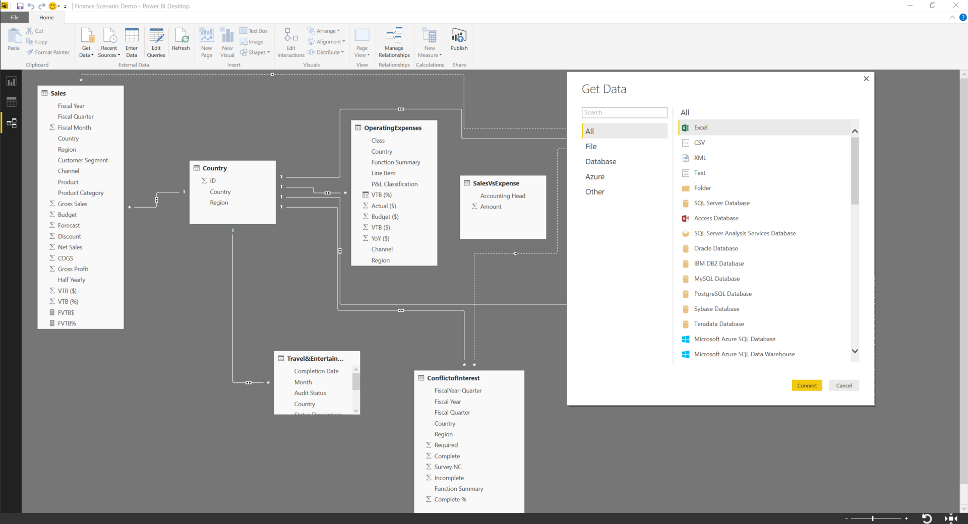
Connect to all the data around you
One data preparation experience across Excel & Power BI Desktop
Data Source
Connect to a broad range of data across on-premises and cloud
Shape, transform, and clean data for analysis
Join and model data from multiple data sources and different types
Extend your analysis with support for technologies such as R for advanced analytics
Data Source
Data Source
Notes:
Connect all the data around you. How can users combine data from multiple sources and of multiple data types, across on-premises and cloud, into a set of reports and dashboards? This is where Power BI Desktop and Excel come in. These are powerful analytical tools for use by business analysts – with them analysts can connect to a wide range of data sources; cleanse, transform and model interrelationships between the data; explore the resulting mashed up datasets and create beautiful, interactive reports or powerful spreadsheets.
One data preparation experience across both desktop tools. We put the same based capabilities and engines for data preparation into both tools. Anyone who knows how to use one tool will automatically know how to use the other. This full data preparation experience includes the following set of capabilities:
Connect to a broad range of data across on-premises and cloud sources. In the connection dialog of both tools we provide a long list of data connectors for sources across flat files, databases, SaaS applications, Big Data technologies such as Spark, and others, and we continue to add to this list on a regular basis. With these data connectors business analysts can connect to all the data they need to access for their analysis.
We also provide powerful capabilities that allow users to shape, transform, and clean this data for analysis. Data is rarely in the right format for analysis and a self-service business analysis tool must provide the flexibility to transform and clean data before it can be properly analyzed. We provide these capabilities as an integrated part of the data preparation experience, providing a more flexible, and ultimately a faster, experience for business analysts to work with data and build reports.
We provide one of the industries leading modeling experiences, for joining this data from multiple data sources together across different types and sources, for analysis and for creation of custom calculations and measures. Leveraging the same powerful modeling capabilities and in-memory engine as in our server technology (SQL Server Analysis Services), we provide business analyst with a complete range of modeling capabilities.
We also provide extended capabilities allowing analysts familiar with technologies such as R to incorporate this work into their reports incorporating advanced analytic to their analysis.

Slide 33
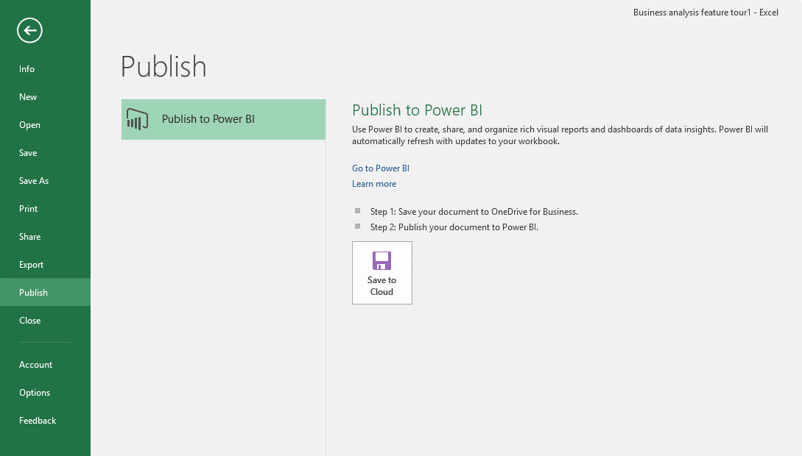
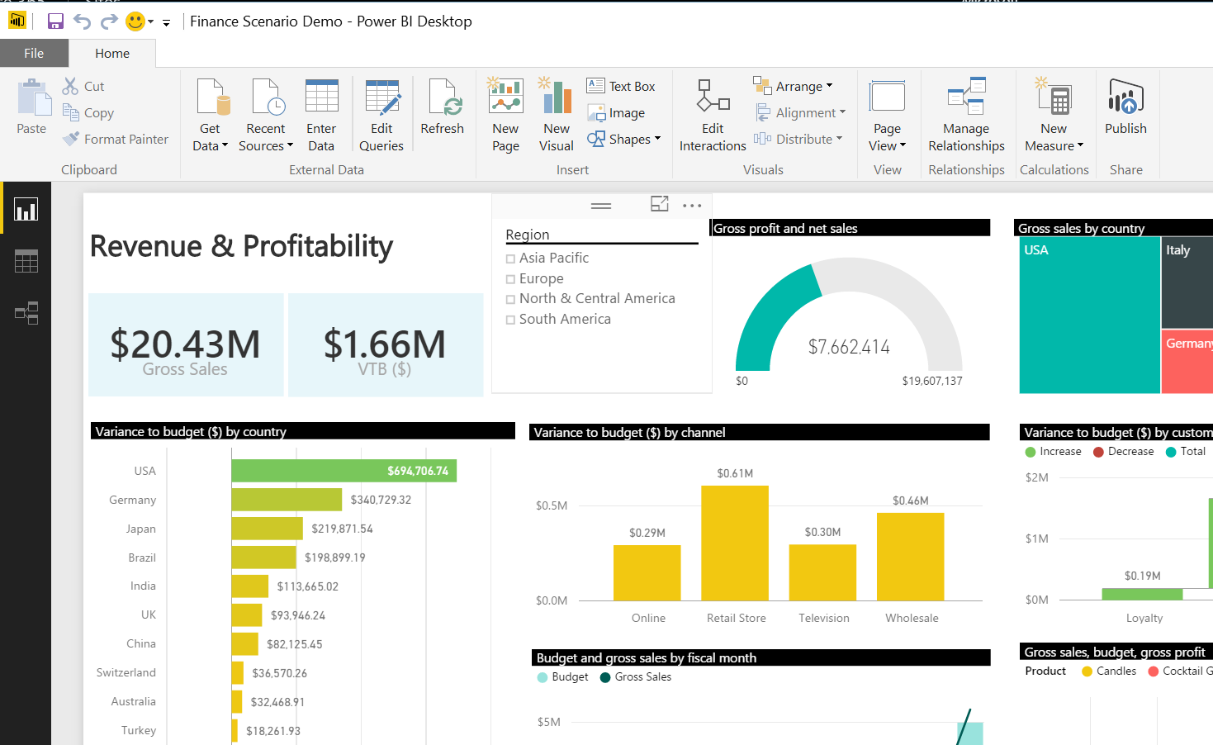
One-click publish to Power BI
Excel
Power BI Desktop
Notes:
Both Excel and Power BI Desktop are seamlessly integrated with the Power BI service. With a single click, these live spreadsheets and reports can be published and refreshed from the Power BI service for ease of access for business users across the organization.

Slide 34
Demo

Slide 35
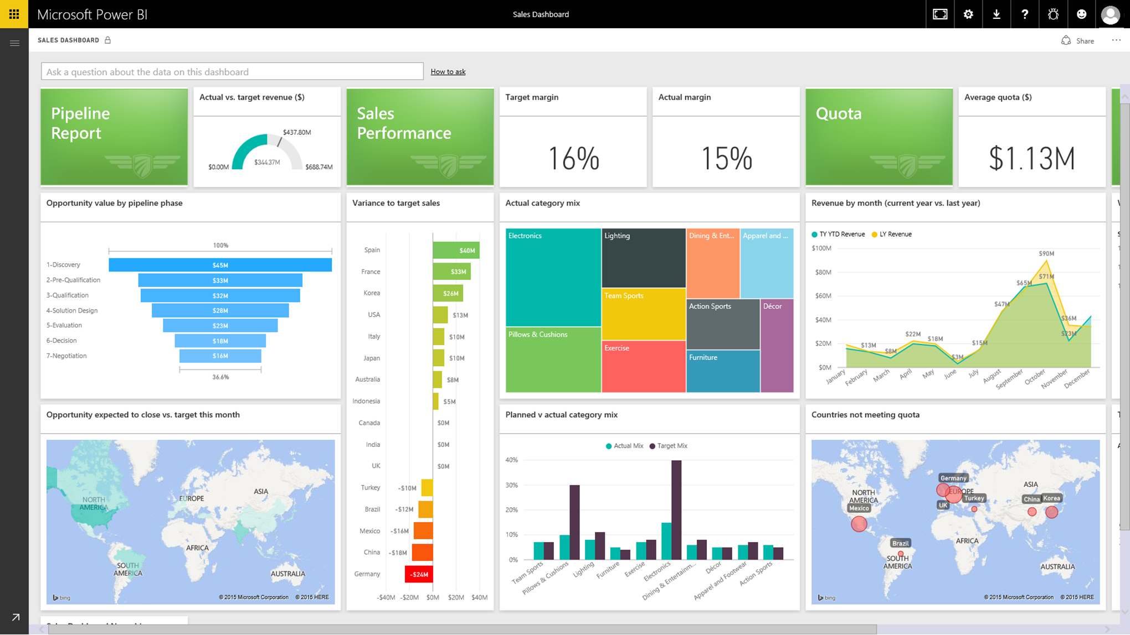
Deploy quickly with a hybrid solution
Live Power BI reports & dashboards
Access on-premises data any way you like
Scheduled refresh
Live connection
Connect to on-premises SQL Server Analysis Services models
Tabular and multidimensional
Cloud
Live connection or
scheduled refresh
On-premises
SQL Server Analysis Services
Data Source
Notes:
Connect live to on-premises Analysis Services models
Realize the benefits of a cloud based BI solution without having to move your data. With Power BI gateways you can create a secure connection to SQL Server Analysis Services from Power BI. When users view and explore dashboards and reports the system will interactively query the on-premises cube to fetch the data using the user’s credentials. With this hybrid solution, you can continue to manage and secure your data on-premises, removing the need to have data reside in the cloud.
The gateways provide the flexibility you need to meet individual needs, and the needs of your organization.
Live connection option are live Query to SSAS or direct query to SQL Server data sources and other data sources.
Scheduled refresh to all supported data sources.
FAQ:
How does security work with the new SQL Server Analysis Service connector?
Power BI customers can benefit from the role level security in SQL Server Analysis Services. The Power BI user name is passed through to on-premises Analysis Services and appropriate role-based security. Analysis Services resolves the user name to an authorized user via Azure Active Directory (more info:: http://support.powerbi.com/knowledgebase/articles/505323-why-you-need-dirsync-to-connect-to-on-premises-ana) and then applies appropriate role-based security to restricted access.

Slide 36
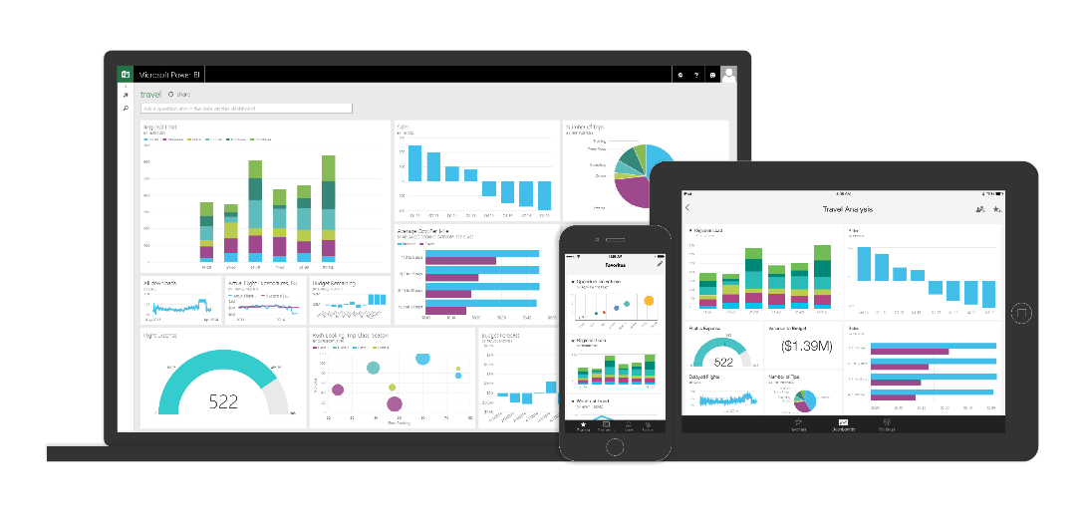
Seamless integration across the Microsoft Data Platform provides quicker and more cost effective deployment for any data project
Data Warehouse
Internet of Things
Big Data
Advanced Analytics
Notes:
To allow customers to get stated quickly we now provide new out-of-the-box connectors for Salesforce, Zendesk, Marketo, SendGrid, GitHub, Dynamics CRM Online, and Dynamics Marketing. With an existing subscription to one of these services, customers can login from Power BI and get rich content in the form of dashboards, reports and datasets.

Slide 37
Power BI for developers
Embed Power BI experiences directly into your public facing websites and blogs
Extend Power BI and your reach with organizational content packs and custom visuals
Integrate user-defined Power BI experiences into your app
</>
Notes:
Speaker Notes-
We are making investments in Power BI to make it a compelling platform for developers and ISVs
Now one can embed Power BI visuals in websites and blogs for public anonymous access. This will allow enterprises to tell public facing data stories with ease .
2. Power BI is an open and extensible platform. You can develop custom visuals on demand to support you business requirement . Developers can started quickly with Microsoft’s open-sourced, production-quality visualization code.
3. You can create Power BI organizational content packs for your users and groups to consume pre-configured Power BI solutions with ease
4. Integrate user-defined Power BI experiences into your custom apps
Easily enable your users to pull their Power BI tiles, dashboards or reports into your custom apps with Power BI integration APIs
We have a strong roadmap for Power BI as a platform for developers. Please visit dev.powerbi.com for latest updates and upcoming releases

Slide 38

Metro Bank
“Microsoft Power BI is our only BI solution. We had a solution previously that was fine for us as a brand new startup organization. But as we grew, we needed something more dynamic, more visually appealing and more user-friendly for our colleagues. Power BI fits the bill in all of those respects.”
Bruce Rioch, Head of Business Information and Customer Systems
Notes:
Metro Bank, the first new “High Street” bank in more than a century, has 27 stores and more than 350,000 customer accounts with a target of growing to 1M customers by 2020.
The first time the bank evaluated Power BI they had just launched a mobile banking solution:
The bank launched mobile banking on a Tuesday.
On Thursday the team gathered the first data on how customer were using it.
On Friday, they used the Excel and the new features to clean up and sift through the data.
Over the weekend they spent 2 hours creating a Power BI dashboard to give executives and colleagues a highly visual, at-a-glance view of how many people were using it to make payments, view balances and transactions, find a nearby branch, and perform about 20 other functions.
Today:
Today Power BI is used throughout the bank understanding how its customers interact with all its services, including stores, online, telephony, and mobile. Analyzing this information so that they can fine-tune its services and reach its million-customer goal.

Slide 39

NHS
“Linking data for analyses was something we couldn’t do before. With Power BI, it’s simple. Power BI makes the hard things easy. Everything becomes possible.”
Philip Dean,
Head of Department of Pharmacy and Quality Control, North Tees and Hartlepool National Health Services Trust
Notes:
https://customers.microsoft.com/Pages/CustomerStory.aspx?recid=2546

Slide 40

It’s easy to get started…
PowerBI.com

Slide 41

SQL Server 2016
Comprehensive, enterprise-ready BI platform
Visualization
Power BI
Pin paginated report items to
Power BI dashboards
Mobile and paginated reports
Modeling
Access
on-premises data
Tabular
Multidimensional
On-premises
Cloud
Notes:
Key points: SQL Server 2016 delivers a comprehensive, enterprise-ready BI platform that enables you to transform data into actionable insights to drive the business in new ways.
Talk track:
In SQL Server 2016 we continue to invest in on-premises and hybrid business intelligence capabilities enabling organizations to build on their existing investments and create, manage and consume business insights on-premises and the cloud.
Both SQL Server Reporting Services and Analysis Services receive major enhancements and deliver modern and mobile reporting and powerful modeling capabilities.
SQL Server 2016 also enables hybrid BI scenarios. You can benefit from your existing investments by accessing on-premises data sources from the cloud without the need to move the data. To monitor all important charts and metrics in one place you can pin paginated report items to your Power BI dashboard and then open the report to drill down into the details.
In this presentation we will provide you with an overview of our short term and long term roadmap for SQL Server reporting and Power BI as well as walk you through some of the key enhancements in BI capabilities in SQL Server 2016.

Slide 42
Enterprise scale models with in-memory technology built-in
SQL Server Analysis Services 2016
Easily create models
Use SQL Server Analysis Services as a semantic model without storing data High performance DirectQuery for Tabular
Make it easier to create powerful models Tabular modeling capabilities and performance
Improve manageability and security Provide additional tools for administrators
Strengthen multidimensional Performance and other updates
IT pro
BI consumers
Faster time to insight
Share insights faster
Business analyst
Notes:
Key Points: Scale models with in-memory technology built in – enabling faster time to value. Transform complex data in your organization into valuable assets that can be used across the business. Easily transform complex schemas into a more business user friendly environment to provide faster time to insights and increase user adoption.
Talk Track:
The investments in SQL Server Analysis Services can be grouped into 4 major themes:
Use Analysis Services as a semantic model without storing data IT spends a lot of time in developing a data architecture for their organization. To give the business users access to all this data in a simple and intuitive manner they build a semantic model on top of the data. Some organizations have made significant investments in a fast, large infrastructure that contains all their data, moving all that data to SSAS might not be desired due to processing times and size considerations. Direct Query mode enables organizations to take advantage of the BI Semantic Model, make data more consumable and provide direct access to their data infrastructure, no data is loaded into Analysis Services.
Make it easier to create models The several enhancements are planned to help IT to more easily create powerful tabular models
Improve manageability and security for both Multidimensional and Tabular models In SQL 2016 we plan to deliver additional tools and capabilities for administrators.
Strengthen Multidimensional The following enhancements are planned for Multi-dimensional models.
Performance updates
Visualize and explore existing models with Power BI and Power BI Desktop
Drill-through multi-selection support with Excel 2016 (example when using slicers)

Slide 43
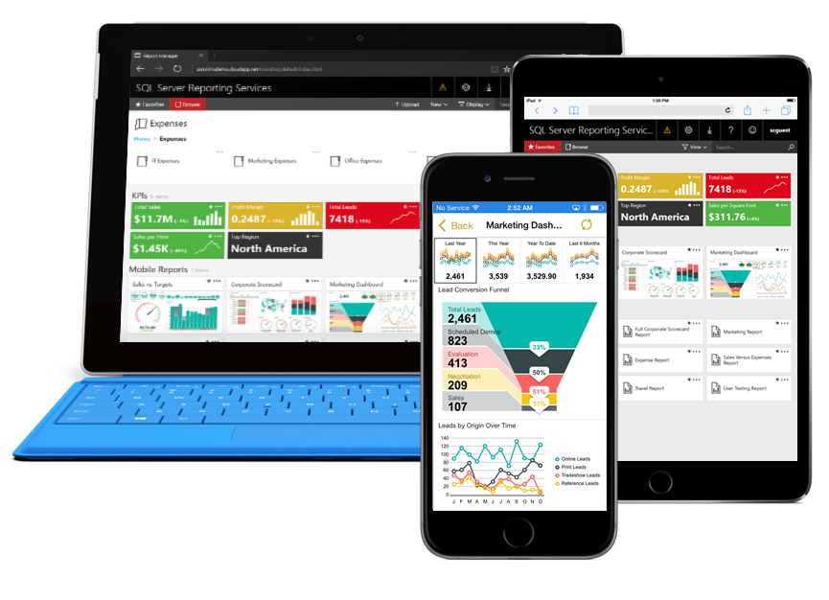
SQL Server Reporting Services 2016
On-premises solution for deploying and managing reports
Paginated reports Design beautiful documents using updated tools and new features
Mobile reports Create responsive, interactive reports optimized for mobile devices
New web portal Consume both types of reports in one web portal using modern browsers
Notes:
Key Points:
This is the overview slide of what’s new for Reporting Services in SQL 2016.
Talk Track:
With the release of SQL Server 2016 Reporting Services brings modern design to enterprise reporting.
SQL Server 2016 enhances Reporting Services with modern design tools
Modern Report Builder look and feel and Visual Studio 2015 support
In SQL 2016 we will enable mobile reports that are optimized for mobile devices and can be consumed on any device and form factor
And a new web portal experience, which is built on HTML5 and optimized for modern web browsers.

Slide 44
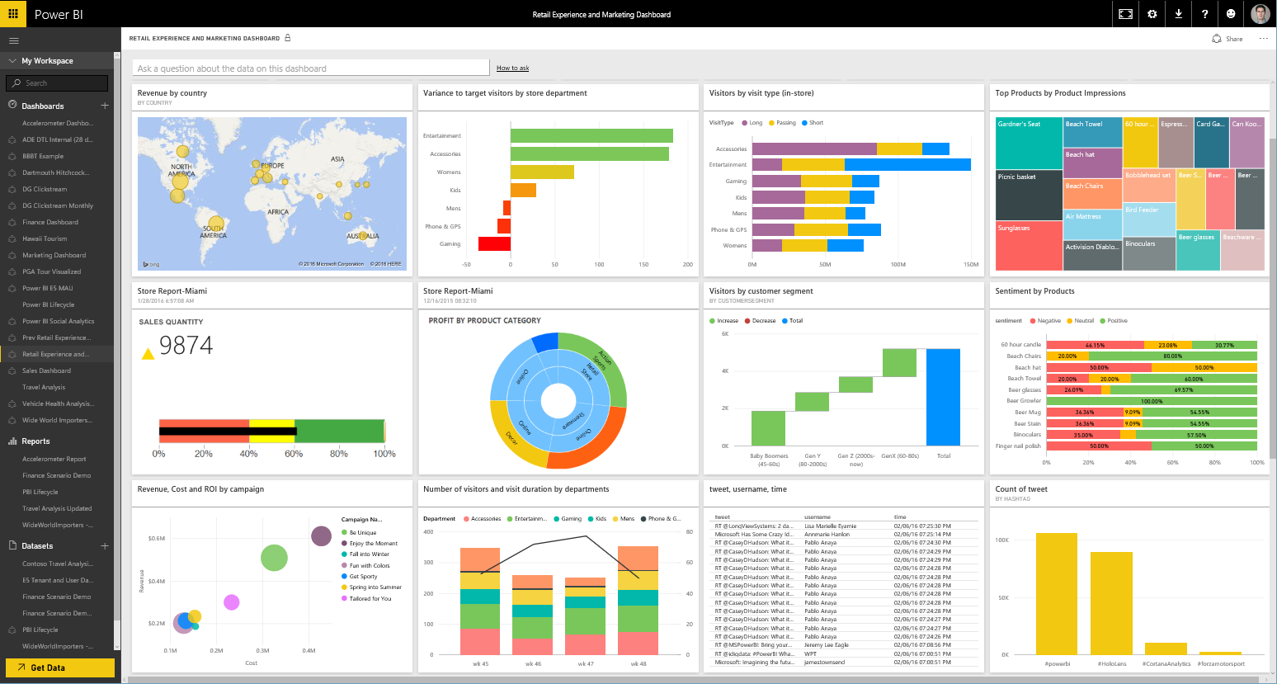
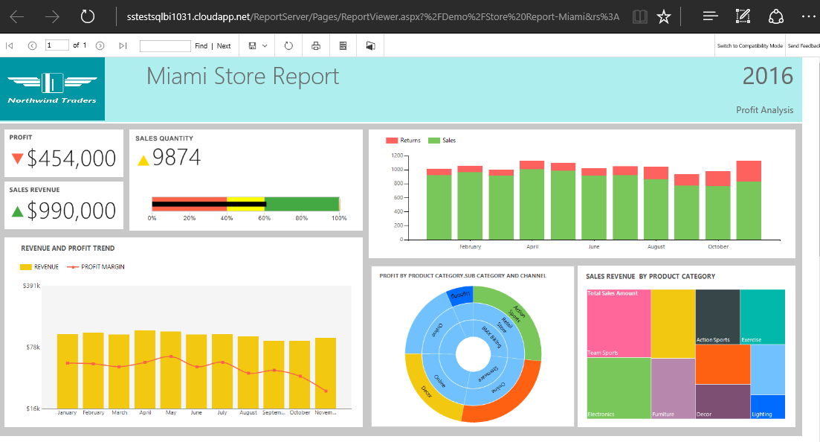
Pin report items to Power BI dashboards
Get more from existing Reporting Services investments
Monitor the most important metrics and trends in one place
Pin charts, gauges, maps, and images as tiles to Power BI dashboards
Drill through to source reports
Refresh tiles on a schedule
Power BI
Reporting Services
Notes:
Key Points:
View most important metrics in one place by pinning Reporting Services paginated report items to your Power BI dashboard.
Talk track:
In addition to using Reporting Services on-premises, you can now use Power BI dashboards to monitor the metrics and trends that matter to you. You can harness your on-premises reporting investments and extend it to the cloud. Business users can pin paginated report items to their Power BI dashboards, enabling them to monitor the most important metrics and trends at a glance in one place. The original reports remain one click away, ensuring that people can drill through to the details when necessary.

Slide 45

Create powerful reports with Power BI desktop
Discovery & exploration – integrated experience for connecting and preparing data for visual data exploration
Easy report authoring – freeform canvas for drag-and-drop report design
Custom visualizations – create your own custom interactive visualizations
R integration – extend your reports with advanced analytics through support for R
Notes:
Power BI Desktop is a self-service BI tool designed to allow users to pull data together from multiple different data sources. Transform and clean that data. Model and add custom calculations. And then visually explore and create interactive reports that can be easily published and shared through the Power BI service.
In addition – you can now create your own custom visualizations though our open source visualization framework. More information available at powerbi.com/visuals

Slide 46


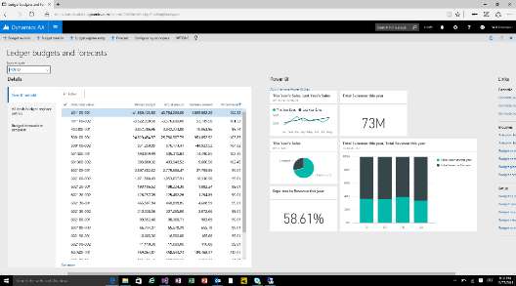
Microsoft business intelligence & analytics
Analysis/authoring
Delivery
Web
Excel
SQL Server Reporting Services
Power BI
Power BI Desktop
On-premises
Cloud
SQL Server Mobile Report Publisher
Mobile
SQL Server Report Builder/
Report Designer
Azure data services
Office 365
SQL Server Analysis Services
Apps
Databases and other data sources
Dynamics
Partner apps
On-premises data
Microsoft cloud data
Non-Microsoft cloud data

Slide 47
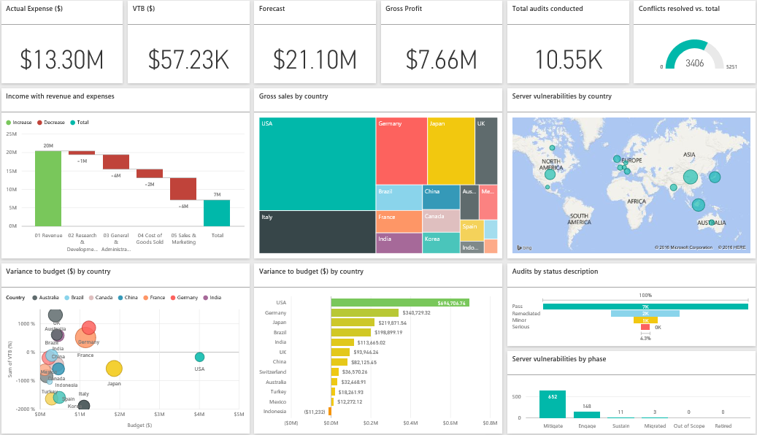
Power BI
Power BI transforms your company’s data into rich visuals and analytics. Stay in the know, spot trends as they happen, and push your business further
Notes:
Key message:
Power BI is a business analytics service. With Power BI you can now see your data through a single pane of glass. Live Power BI dashboards and reports show visualizations and KPIs from data residing both on-premises and in the cloud, providing a consolidated view across your business regardless of where your data lives. It enables someone to better visualize your business and provides a canvas to build the connections to create a 360-degree view of your business.
Talking points:
This is Power BI in a nutshell. The Power BI service offers a simple, intuitive experience for interacting with data. From creating and sharing dashboards to exploring and enhancing reports, Power BI makes it easy to engage with data from heterogeneous sources, fueling faster, more insightful business decisions. With Power BI, you get a rich, consolidated view of key information, no matter where all of the underlying data is stored.
We’ll look at the key benefits and differentiators on the next slide

Slide 48
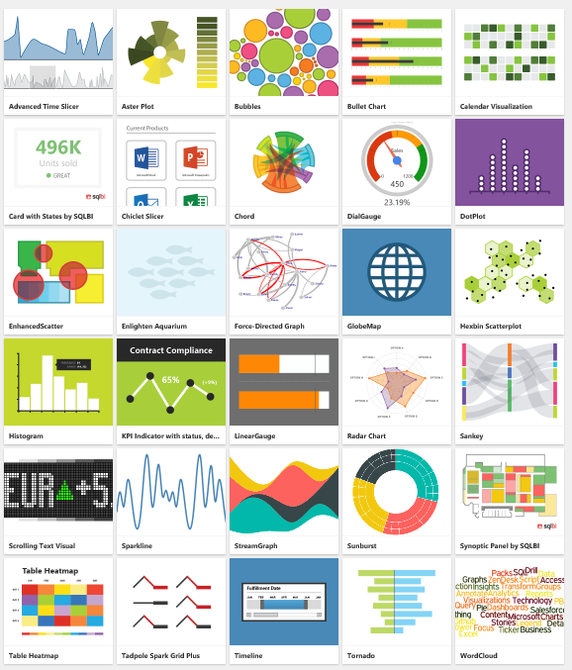
Visualize any data any way with Power BI custom visuals
Notes:
We’re enabling developers to easily add custom visuals into Power BI for use in dashboard, reports and content packs. To help you get started, we’ve published the code for all of our visualizations to GitHub. Along with the visualization framework, we’ve provided our test suite and tooling to help the community build high quality custom visuals for Power BI. All of this is available as an open source project on GitHub. You can also visit www.powerbi.com/visuals to visit our community authored visuals gallery , download visuals and get started.

Slide 49
Today’s discussion
Overview
Power BI Premium
Power BI service
Power BI data sources
Power BI Desktop
Summary

Slide 50
Overview
Power BI Premium
Power BI service
Power BI data sources
Power BI Desktop / Visio integration
Summary

Slide 51
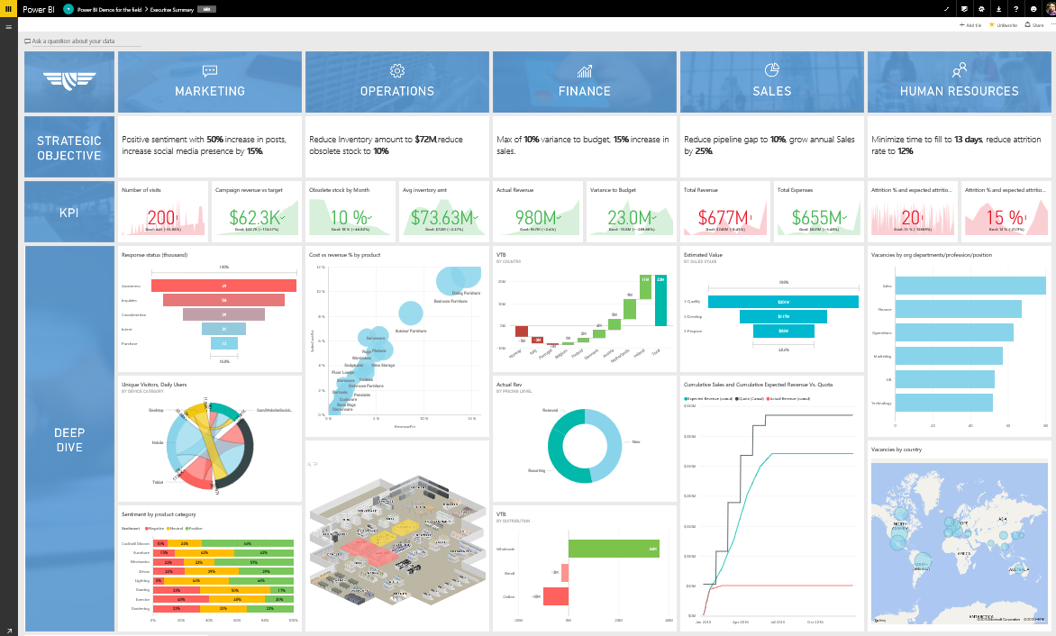
Connecting any user, in any business, anywhere, with their data
Power BI
Industry-leading SaaS service
5 seconds to sign up, 5 minutes WOW
Large Power BI ecosystem
ISVs, SIs and partners creating unparalleled momentum
Integrated across Microsoft products
Customers benefit from integration with other Microsoft products
Notes:
Key message:
Power BI is a fundamentally groundbreaking offer
Talking points:
A service for non-technical business users and analysts to connect with their data
Users get value out of their data that was previously impossible, required complex technical expertise to connect with data, model the data, and create reports
Power BI connects any user, in every business, in every country with their data
Goal: connect 1B people to their data with Power BI
Power BI integration across Microsoft:
Connects to Azure Stream Analytics, Machine Learning, SQL Database, SQL Data Warehouse, SQL Data Lake, SQL Server, Office 365

Slide 52
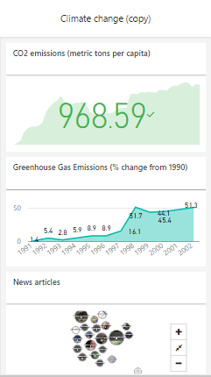
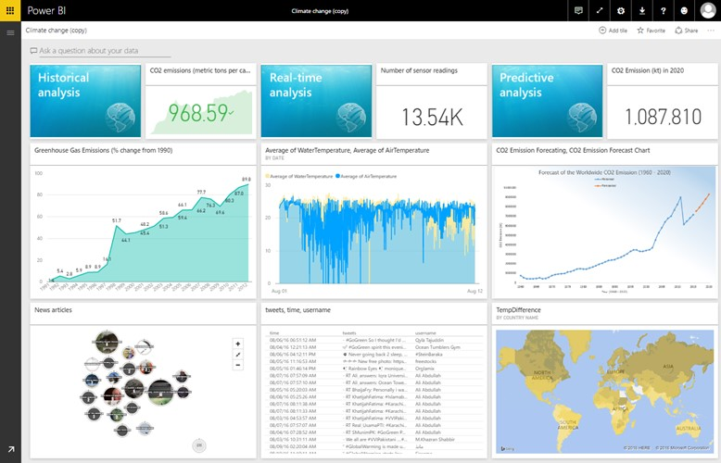
Key benefits and differentiators of Power BI
Pre-built dashboards and reports for popular SaaS solutions
Live, real-time dashboard updates
Secure, live connection to your data sources, on-premises and in the cloud
Auto insights and intuitive data exploration using natural language query
Integrated with familiar Microsoft products, utilizing commitment for scale & availability in Azure
Fast deployment, hybrid configuration, secure and integrated with existing IT systems
Notes:
Key message:
There are several capabilities that differentiate Power BI from other offerings in the market.
Talking points:
Power BI is a cloud-based analytics service that provides faster time to insight. It is used for visualizing, exploring and extracting insights from data. It brings together data from diverse sources to deliver rich, comprehensive views of business operations.
What that means is, with Power BI, you can see all of your data through a single pane of glass, and create an analytics environment in minutes to monitor data and share reports. Live dashboards and reports show visualizations and KPIs from data that reside both on-premises and in the cloud, providing a consolidated view across your business regardless of where your data lives.
There are several capabilities that are unique to Power BI – these include:
Pre-built dashboards and reports for popular SaaS solutions such as Marketo, Salesforce, GitHub, ZenDesk, Dynamics CRM, and many others.
Dashboards and visualizations that support real-time updates.
Secure, live connection to on-premises data sources to drive insight across the entire range of organizational information (Analysis Services, Azure SQL Database, SQL Database Auditing, Azure SQL Data Warehouse).
Automated scheduled refresh to keep Power BI data in sync with on premises data sources.
Native mobile applications for keeping users connected on the go.
Easy integration with other Microsoft offerings, from Excel to Azure services.
Intuitive data exploration, which enables users to ask questions of their data in plain English.
To summarize, Power BI is a SaaS offering that enables anyone to easily connect to their data, create live operational dashboards and explore data via interactive visualizations.

Slide 53
Power BI Overview
Data sources
Cloud-based SaaS solutions e.g. Marketo, Salesforce, Quickbooks, Google Analytics, …
On-premises data e.g. Analysis Services, SQL Server
Organizational content packs Corporate data sources or external data services
Azure services Azure SQL, Stream Analytics…
Excel and CSV files Workbook data, flat files
Power BI Desktop files Data from files, databases, Azure, Online Services, and other sources
Power BI Service
Natural language query
Sharing & collaboration
Content packs
Live dashboards
Visualizations
Reports
Datasets
Data refresh
Notes:
Let’s walk through an overview of what Power BI is.
1. The Power BI Service, sometimes referred to as powerbi.com, is what allows you to:
Create beautiful visualizations to tell compelling data stories.
Build rich, live dashboards that turn BI into business insights.
Create reports & datasets from which you can create visualizations and dashboards.
Enjoy the benefits of up-to-date data with real-time, automatic and scheduled refreshes.
Share dashboards easily with other people in your organization.
Ask questions of data in plain English with Natural Language Query.
Stay connected to data all the time with mobile applications.
2. Power BI connects to a variety of data sources. These range across both cloud and on-premises sources, and include:
A variety of popular SaaS solutions, such as Marketo, Salesforce, GitHub, Dynamics CRM, Zendesk, and several others.
On-premises databases – Power BI offers live connectivity to SQL Server Analysis Services and others, which we’ll cover in more detail later. And using a gateway solution, Power BI can connect to other database solutions.
Custom data sources – Power BI can connect to any data source you need it to thanks to its extensibility via REST APIs. This includes both proprietary corporate data sources, as well as external data services. For example, if you are a SaaS solution provider, you can work with Microsoft to connect your solution to Power BI.
Other Azure services – Power BI integrates tightly with SQL Azure and Stream Analytics, and will be integrating closely with more Azure services over time.
Power BI Desktop, Excel and CSV files – Excel workbooks can be directly connected to Power BI.com, or may be used with Power BI Desktop. Power BI Desktop is the companion application to the Power BI service – it is a desktop tool that supports data analysis and reporting. Like Excel files, or CSV files, Power BI Desktop files can be uploaded to the Power BI service.

Slide 54

Power BI Overview
Data sources
Power BI Service
Cloud-based SaaS solutions e.g. Marketo, Salesforce, Quickbooks, Google Analytics, …
On-premises data e.g. Analysis Services, SQL Server
Organizational content packs Corporate data sources or external data services
Azure services Azure SQL, Stream Analytics…
Excel and CSV files Workbook data, flat files
Power BI Desktop files Data from files, databases, Azure, Online Services, and other sources
Content packs
Natural language query
Sharing & collaboration
Live dashboards
Visualizations
Reports
Datasets
Data refresh
Power BI Desktop
Power BI Platform
embed, extend, integrate
Prepare
Explore
Report
Share
</>
Notes:
There is more….
3. Power BI Desktop is a visual data exploration tool that enables you to analyze data and create stunning reports. With Power BI Desktop, you are able to:
Acquire and prepare data using extensive query capabilities.
Manipulation and consolidation of multiple data sources is performed in Power BI Desktop – this enables Power BI service users to use data from multiple sources in a single report.
Establish data structure, then transform and analyze data.
Visualize and explore your data in new ways through a freeform drag-and-drop canvas.
Author reports with a broad range of modern data visualizations.
Publish beautiful, interactive reports directly to powerbi.com.
Securely share reports through unique, curated content library approach.
4. Finally, the Power BI Platform allows you to embed, extend, and integrate Power BI into other applications and environments.

Slide 55
Overview
Power BI Premium
Power BI service
Power BI data sources
Power BI Desktop / Visio integration
Summary

Slide 56
Introducing Power BI Premium
Flexibility to license by capacity
Greater scale and performance
Dedicated
resources
in the cloud
Extending on-premises capabilities
Power BI Premium
Embedded
analytics
Notes:
Refer to Power BI Premium overview talk track for overview slides

Slide 57
Flexibility to license by capacity
Extend read access to a broader set of people without requiring per user license
Tailor performance to the unique needs of your organization, department, or team
Scale as your requirements change.
Notes:
Refer to Power BI Premium overview talk track for overview slides

Slide 58
Flexible content distribution
Assign workspaces to premium
capacity
Publish
Power BI apps
Power BI Premium
Premium capacity
Consume apps throughout an organization
Notes:
Refer to Power BI Premium overview talk track for overview slides

Slide 59
Greater scale and performance
Dedicated hardware for exclusive use by the tenant fully managed by Power BI
Easily scale on-demand based on the actual use
Performance and scale fully controlled by the admin
Notes:
Refer to Power BI Premium overview talk track for overview slides

Slide 60
Extending on-premises capabilities Power BI Report Server
Flexibility to keep reports on-premises
Compatibility with SSRS reports
Concurrently deploy an equivalent number of cores on-premises
Notes:
Refer to Power BI Premium overview talk track for overview slides

Slide 61
Embedded analytics
Full Power BI capabilities in your applications
Predictable pricing based on consumption of your apps
Open and extensible platform
Notes:
Refer to Power BI Premium overview talk track for overview slides

Slide 62
Power BI portfolio
Power BI Desktop
Power BI Free
Power BI Pro
Power BI Premium
Licensed by
user
Licensed by
user
Licensed by
user
Licensed by capacity
Free report authoring and ad-hoc data exploration
Quick, easy-to-use self-service analytics for personal use
Quick, easy-to-use self-service analytics for users requiring collaboration, dashboard sharing, ad hoc analysis, and report publishing
An add-on to Power BI Pro for projects requiring large scale data, demanding performance, and the ability to distribute content without requiring per user licensing

Slide 63
Performance enhancements
Noisy neighbor isolation
Enhance performance by moving workspaces to dedicated hardware
Real-time cache/pin to memory*
Run queries at lightning speed with in-memory data storage
Incremental/dedicated refresh*
Get the most up-to-date insights with near real-time data refresh
Secondary model copies*
Support business continuity and disaster recovery by creating backups of your models
Geo replicas*
Reduce latency by replicating instances around the world
* These features will be available post-GA

Slide 64
Overview
Power BI Premium
Power BI service
Power BI data sources
Power BI Desktop / Visio integration
Summary

Slide 65
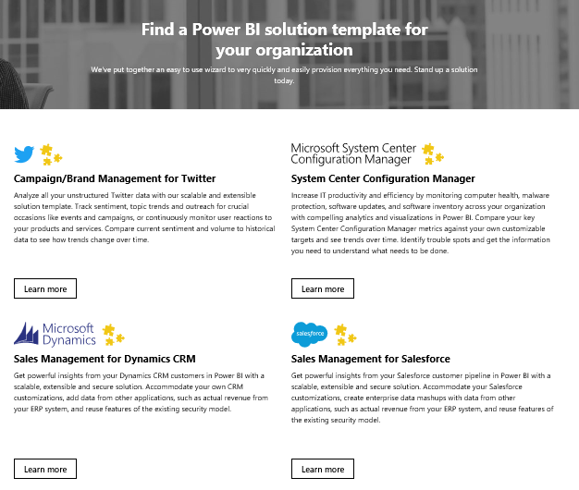
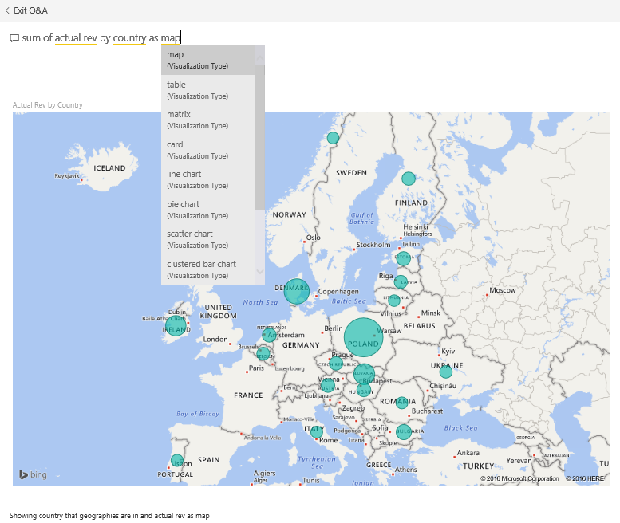
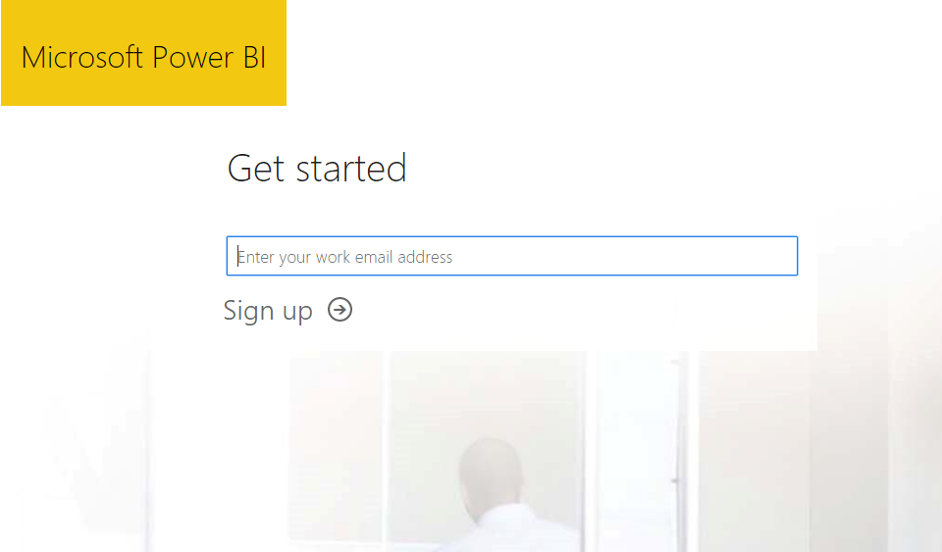
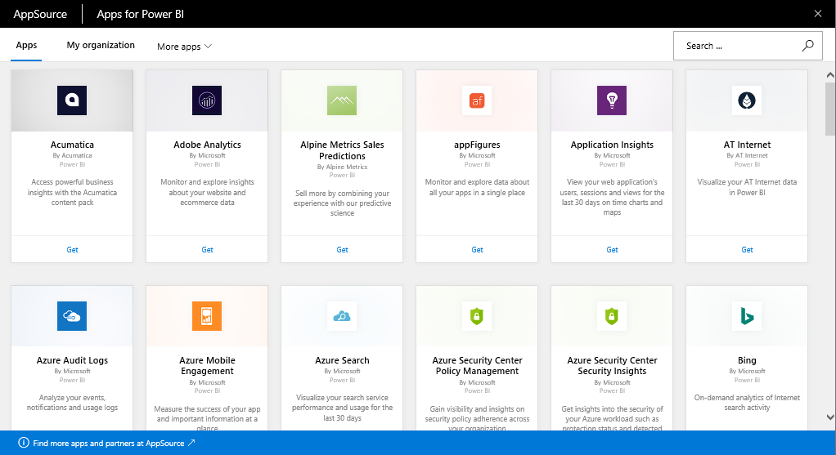
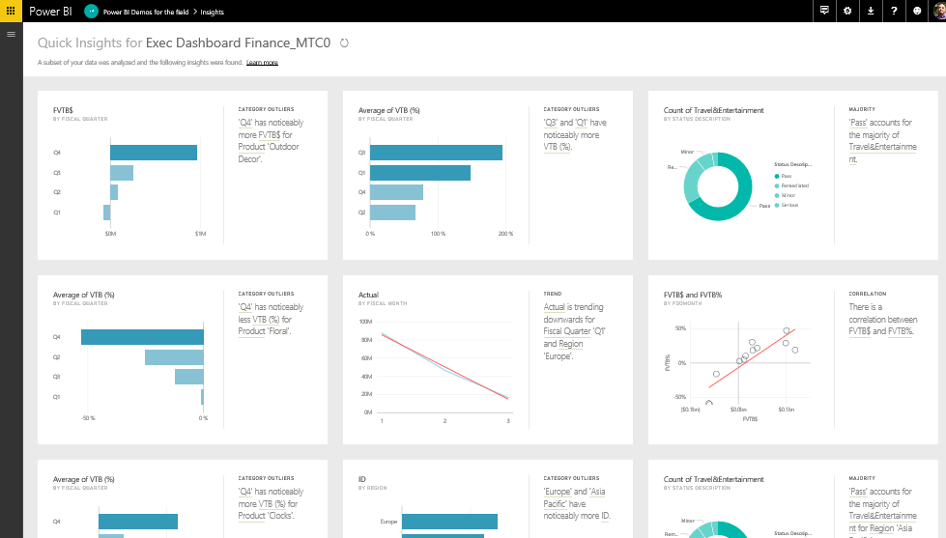
Get started quickly
Free sign up in seconds
Get started with pre-built content for popular SaaS solutions and for your organization
Content packs include pre-configured dashboards, reports, data models and queries
Automatic data refresh is built-in
Quickly provision end-to-end, enterprise – ready solutions with Solution Templates
Get instant answers from your data by asking a question in natural language
Use Quick Insights on a new data set – Power BI will analyze the data and deliver new insights
Notes:
Key message:
Get started quickly with the Power BI Service (powerbi.com) for faster decision-making by displaying all of one’s data in one place.
Talking points:
You can get started quickly with pre-built content packs for popular SaaS solutions, including Salesforce, Google Analytics, Dynamics and many more.
The primary capability of Power BI is that it empowers you to create and customize live dashboards – dashboards that include visualizations from multiple data sources.
That is, dashboards can show different types of data from a variety of sources, and can use a range of unique visualizations.
If applicable, you can track status in real-time thanks to support for real-time data sources.
You have full control over your dashboards – pin any visualization from any report to any dashboard.
Click through visualizations to access underlying reports to discover more data and new insights.
Accelerate Power BI deployments with solution templates - you don’t need to start from scratch. Start with a working end-to-end enterprise-ready Power BI solution for Salesforce, Dynamics, Twitter, System Center Configuration Manager

Slide 66
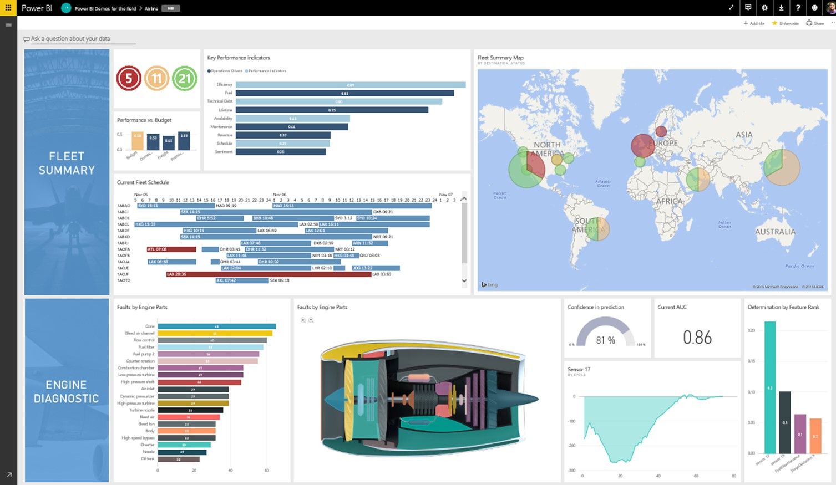
Create dashboards for what matters most
Build dashboards to monitor your most important business metrics, at a glance
Combine on-premises and cloud-born data in a single pane of glass
Data is visualized as tiles that you can resize, move, rename, pin, delete, or add a hyperlink
Choose different views (Full Screen, Fit to Screen, In-Focus)
Set your featured and favorite dashboards for what you visit the most
Add images, videos, web code or text boxes
Control the color scheme of your dashboard
Create dashboards by pinning visualizations from reports, Q&A, other dashboards, Reporting wan Services, Excel
Notes:
Key message:
With Power BI dashboards you can monitor your business through a single pane of glass
Talking points:
Create personalized dashboards to monitor your most important data, at a glance.
A dashboard combines on-premises and cloud-born data in a single pane of glass, providing a consolidated view across the organization regardless of where the data lives.
Each metric, or insight, is displayed on the dashboard as a tile.
Choose which dashboard to pin a visual to, either an existing visual or one that is created.
Pin a tile from one dashboard to another.
Dashboard display modes: Full Screen, Fit to Screen.
In-focus (full screen) mode for tiles.
Last update time and source information shown on tile in in-focus mode.
Control the visual colors in the dashboard. Dashboard theme can be different from report theme to achieve consistency across visuals.
More resize options for your tiles: choose from size 1x1 up to 5x5 tile units.
Add text, images, shapes, and videos to your dashboard
Set your featured and favorite dashboards
Receive data-driven alerts and other Power BI alerts in the Notification Center
Classify data, e.g. High Business Impact (HBI), Low Business Impact (LBI)

Slide 67
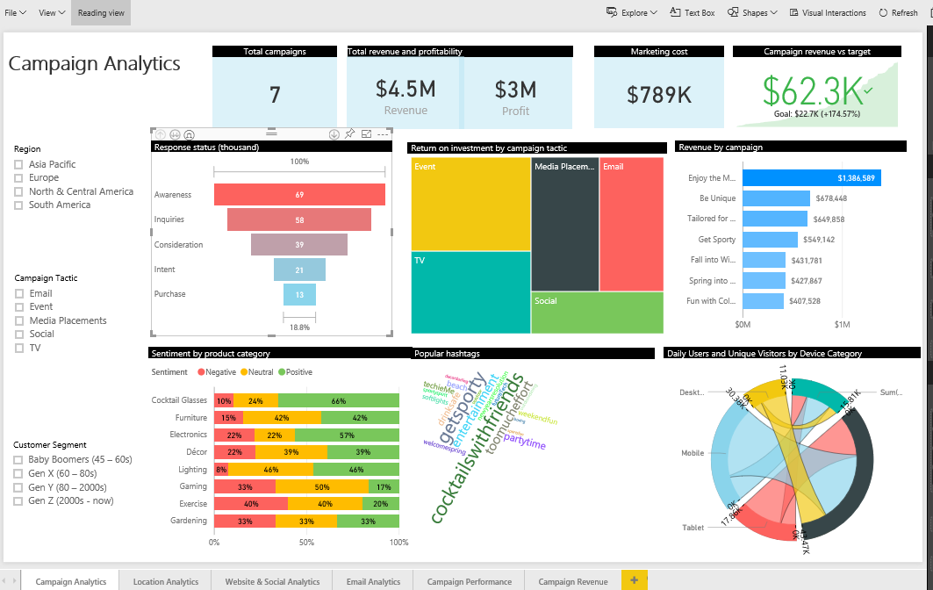
Explore your data and uncover new insights
Select a dashboard tile to go directly to the underlying report or Q&A
Dig deeper into reports (Reading View)
Reading View for reports that are shared with you
Highlight a value in one visualization to change others
Drill-down in your hierarchical data
Filter, sort, hover over and highlight data
Control how a report is displayed
Export to PowerPoint
Explore and design a report (Editing View)
Editing View + Reading View for reports that you own
Create new visualizations
Use desired data fields for your visuals
Format your visuals – type, colors, filters
Add text and shape elements
Add new pages to your report
Notes:
Key message:
Power BI you can create reports from a dataset and surface them where you need them.
Talking points:
A report consists of a set of charts and other data visualizations, all drawing from the same underlying dataset.
Choose from different ways to build a report.
Create a report from scratch.
Select a read-only, pre-authored report.
Apply a default report format for an individual data set.
Generate as many reports as needed from a single data set.
Draw from a range of visualizations in any given report to tell a compelling data story— this applies to both new and existing reports.
Pin reports directly to dashboards to keep the right data top-of-mind.

Slide 68
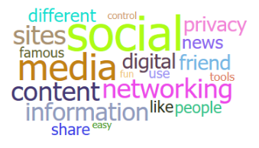
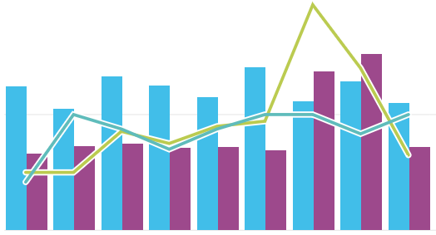
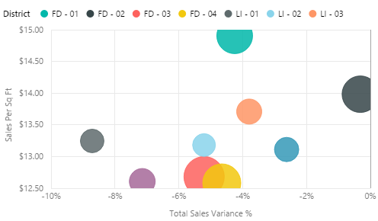
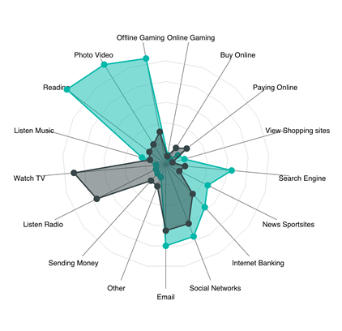
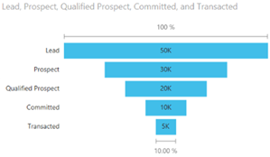
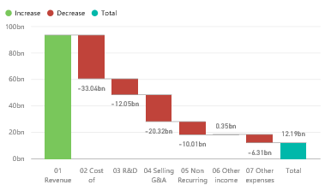

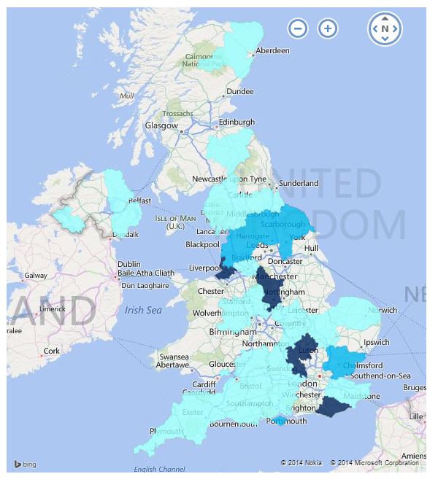
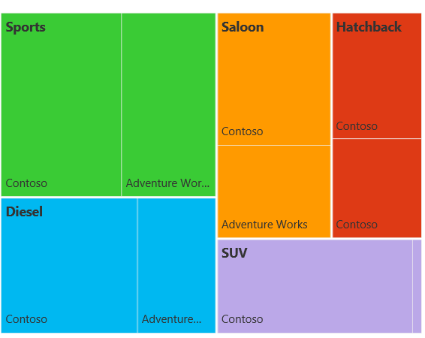
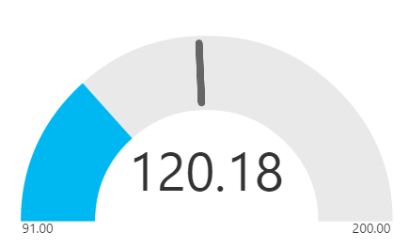
See your data the way you want it
Visualize data to tell your story
Growing number of visualization types
Donuts, basic area, waterfall, filled maps, tree maps, funnel, gauges, combo charts, R charts and more
Custom visuals and R-powered visuals available from Power BI visuals library (visuals.powerbi.com)
Tools to develop, test, package new custom visuals
Visualizations on report page are connected – select value in one visualization to filter other visualizations
Full screen pop out mode for report visuals to show additional details
Notes:
Key message:
See data the way you want it using the array of visualizations that are available in Power BI.
Talking points:
You can experiment with visualizing data in different ways, enabling previously inaccessible business insights.
Select from a growing number of visualization types and different chart types.
Use visualizations that go beyond standard charts – such as slicers, maps, tiles, stand alone images and others.
Cross-filter across visualizations within a report to surface new insights.
The Power BI visuals gallery at visuals.powerbi.com is enabled by the Power BI community. Browse through the visuals or submit one of your own for others to use. Includes R-powered visuals to benefit from advanced analytics without having to know R.

Slide 69
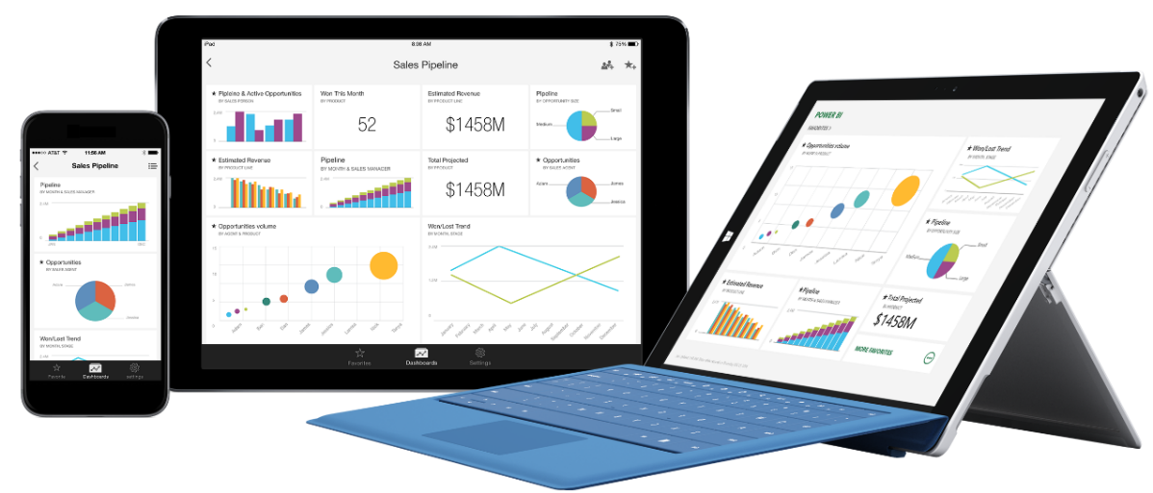
Stay connected from any device
Access Power BI dashboards and reports with native mobile apps for Windows, iOS and Android
Easy sign-in step with support for Single Sign-on (SSO)
Orientation-aware and location aware apps
Annotate visualization and share snapshot with others
Configure data-driven alerts for your critical KPIs
Generate and scan QR codes, or scan bar codes for report filtering
Open and interact with Reporting Services mobile reports and KPIs
Notes:
Key message:
Power BI mobile apps for Windows, iOS and Android make it possible to stay connected to dashboards and reports from any device.
Talking points:
Power BI native applications are available for Windows, iOS and Android devices.
These applications make it easy to access live dashboards and reports securely from anywhere.
Using the same app, you can also open and interact with SQL Server 2016 mobile reports and KPIs.
You can set favorites for easy access to the most important visualizations.
Zoom in and out of a visualization to look at data more closely or rotate the device for landscape/portrait views.
Annotate a report or visualization and share marked-up snapshot with others.
You can configure settings to receive alerts and notifications as data reaches or drops below pre-defined. thresholds, or based on other indicators.
If you are new to Power BI, activate your user account directly from one’s mobile device.
Optimized formatting and display of charts, including % based line charts and data labels.
Improve the scroll and touch gestures of the matrix tile. Easily scroll down one’s matrix tile and get all the data natively and mobile optimized.
Global search and recent items
Multi-select for report slicers
Generate and scan QR codes, use QR codes with augmented reality display
Scan bar codes
Manual refresh
Windows phone: pin KPI, card, or multi-row card as live tile directly to Start screen
Use presentation mode on Surface Hub
Support for Intune Mobile Application Manager (MAM)

Slide 70
Ask questions of your data – the way you would ask a person
Type questions in plain language – Power BI Q&A will provide the answers
Q&A will provide suggested questions, terms and visuals for your dataset
Q&A intelligently filters, sorts, aggregates, groups, and displays data based on the question
Pin the answers to your dashboard
Add your own suggested questions to dataset, e.g. frequently asked questions
Notes:
Key message:
One of the unique capabilities of Power BI is that it lets you ask questions of your data the same way you’d ask a person
Talking points:
Now, even the least quantitatively inclined person can find answers quickly by phrasing data questions in plain English.
Type a question, and powerbi.com answers by generating a relevant chart.
Pin the subsequent chart directly on a dashboard.
Enable the best results by using key phrasing as you build models in Power BI Desktop.
Power BI’s Natural Language Query, or Q&A feature, intelligently filters, sorts, aggregates, groups and displays data based on the key words in the question asked.
By default, you will see a list of suggested questions for tiles on your dashboard or tables in your dataset.
Suggestions will include specific terms from the data (e.g. column names or row values).
Add your own featured questions, e.g. frequently asked questions to your dataset.

Slide 71
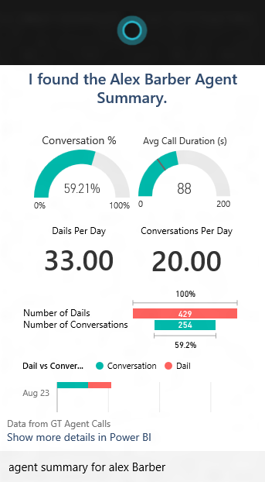
Power BI Cortana Integration
Cortana can find answers from data in Power BI, e.g. “What were our biggest deals that closed last month?”
Similar to Q&A, ask or type a question in natural language
Cortana can find answers directly from dataset or from report pages designed for Cortana (called Answer Pages)
Interact with the visualizations as you would in Power BI, to further explore an answer, simply open a result in Power BI
Cortana ranks the answers from Power BI, giving you one or more best matches
Easily create Answer Pages in the Power BI service
Notes:
Key message:
With the November 2015 update of Windows 10, Cortana can now find answers from data stored in Power BI
Talking points:
To use Cortana to get answers from Power BI, all that is required is to add the work or school account you use with Power BI to Windows 10 and have access to a dataset in Power BI that is enabled for Cortana.
Similar to Power BI Q&A, ask or type your questions using natural language. Cortana will search your Cortana-enabled datasets in Power BI for answers and display results directly in your Windows 10 device.
Cortana can find answers either directly from datasets in Power BI or from report pages published to Power BI and designed specifically for Cortana (called Answer Pages). Interact with the visualizations as you would in Power BI or, to further explore an answer, simply open a result in Power BI.
NOTE: Only datasets hosted in Power BI are supported. Cortana with Power BI does not work with DirectQuery or other direct-connect datasets.
Cortana ranks the answers from Power BI, giving you one or more best matches if there is high confidence a result is a good answer. Other potential answers from Power BI are listed in a Power BI section below any best matches.
More exciting features will soon be available with the Power BI Cortana integration, including predictions, preemptive alerts and line of business process integration.

Slide 72
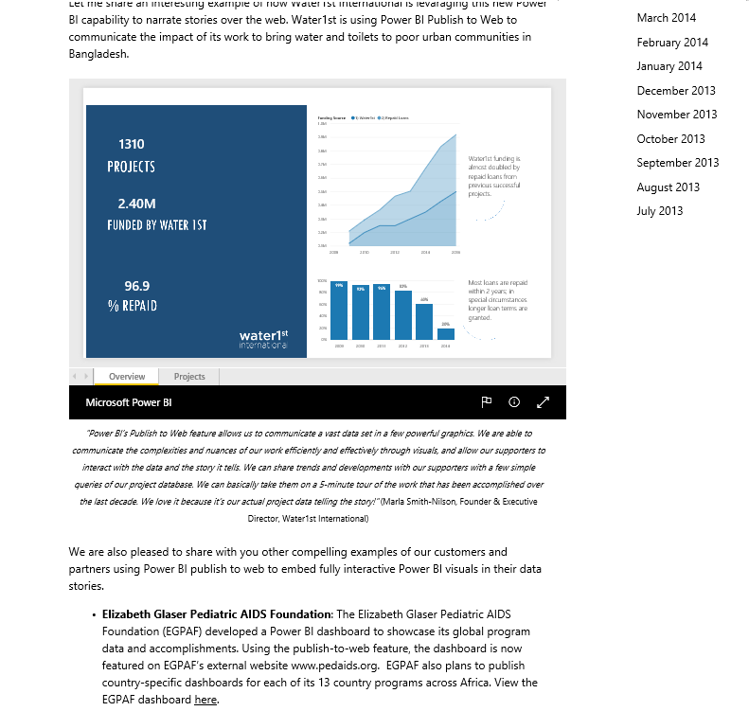
Share your work and collaborate with others
Share a dashboard with colleagues and others
Colleagues in and out of your organization can interact and view dashboards and associated reports (read-only)
Control re-sharing of dashboard
Collaborate in a group workspace
Everyone in group can view and edit dashboards and reports
Members can be restricted to view only
Create a content pack and publish it to your organization
Any user with access to content pack can view and create personalized copies of dashboard, reports
Publish to Content Pack library to share with entire organization or groups
Publish to web
Embed interactive visuals into blog posts, websites, social media, and other online communications, on any device
Available on reports in your personal workspace that you can edit
Notes:
Key message:
In Power BI you can share dashboards, reports, and tiles in several different ways. Each has its advantages.
Talking points:
Share a dashboard with colleagues and others
When you share a dashboard, those you share it with can view it and interact with it, but can't edit it. They can see the same data that you see in the dashboard and reports. Your colleagues can share the dashboard with other colleagues, if you allow them to. Those outside your organization can view and interact with the dashboard, but can't share it..
Make changes to dashboard after you’ve sent it out, and it will automatically sync across all users
Share only your dashboard, keeping access to the source data and reports secure. What this means: Users who receiving a sharing invitation cannot change filters or drill down into data - they only see what’s in the dashboard
Manage who can re-share dashboards with others
Share dashboards based on email or O365 distribution group
Share without email notification, copy and share a link instead, e.g. on another portal
People picker with autocomplete as you start typing the name of recipients
Copy/paste large number of email addresses you want to share with, e.g. copy directly from Outlook
Collapse navigation pane with URL parameter
Collaborate in a group workspace
Groups in Power BI are built on Office 365 groups, so you and your colleagues need a Power BI Pro license. When you're a member of a group, you can create a dashboard in the group workspace. Everyone in the group can view, interact with, and edit the dashboard and its reports. They have the same permission you have
Create a content pack and publish it
Content packs are a great way to share your Power BI insights with your colleagues.
You create a dashboard with its reports and datasets, and then publish them all together as a content pack -- either for your whole organization or for those in a specific security group or distribution list. When those colleagues go to the Content Pack Library for their organization, they see your content pack along with any others they have permission to see
Publish to the web
When you publish Power BI reports to the web, you can embed interactive visuals in blog posts, websites, social media, and other online communications, on any device. Publishing to web is available on reports in your personal workspace that you can edit. You can't publish to the web reports that were shared with you.

Slide 73
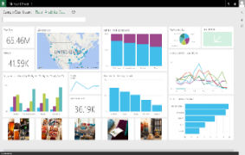
Keep your data where it is and connect securely
Faster time to insight with a hybrid BI solution
Live Power BI Dashboards and Reports
Cloud data sources
SaaS sources
Azure – SQL, DW, Blob, Table, HDInsight, Marketplace
SharePoint, web sources, OData
OneDrive
SaaS, Azure, SharePoint, Web, OneDrive
Cloud
On-premises
On-premise data sources
SQL Server, Teradata, Oracle, DB2, MySQL, PostgreSQL, Sybase, SAP HANA, Access, Custom SQL, ODBC Drivers, R scripts
SQL Server Analysis Services (tabular and multi-dimensional)
Files/folder, SharePoint on-premises
SQL Server Analysis Services
Data Source
Data Source
Notes:
Key message:
Power BI makes it possible to keep your data where it is – on-premise or in the cloud.
Talking points:
Connect to the SaaS solutions that you already use.
Connect to Azure SQL Server, Azure SQL Data Warehouse, Spark on HDInsight using DirectQuery. With DirectQuery, queries are sent back to your Azure data store in real time as you explore the data. This, combined with the scale of Azure, enables users to create dynamic reports in minutes against terabytes of data.
Connect live to your on-premise SQL Server Analysis Services data models – both tabular and multidimensional.
Connect live to your SQL Server, Teradata, Oracle DB2, MySQL, PostgreSQL, Sybase, SAP HANA, Access databases.

Slide 74
Keep your data up-to-date
Access and refresh the data via
Direct Query to cloud and on-premises data sources
Live connectivity to Analysis Services
Import, with scheduled refresh
REST APIs to stream data
Live Power BI Dashboards and Reports
SaaS, Azure, SharePoint, Web, OneDrive
Cloud
On-premises
Refresh on-premise data with
Power BI Personal Gateway
On-Premises Data Gateway
SQL Server Analysis Services
Data Source
Data Source
Notes:
Key message:
Power BI makes it possible to keep all your data current – and visualizations automatically recalibrate when data changes.
Talking points:
Refresh your Azure SQL Server, Azure SQL Data Warehouse, Spark on HDInsight data using DirectQuery. With DirectQuery, queries are sent back to your Azure data store in real time as you explore the data. This, combined with the scale of Azure, enables users to create dynamic reports in minutes against terabytes of data.
With SaaS solutions, data is refreshed automatically, typically on a daily basis.
Data may also be refreshed on demand.
And even without user intervention, data is queried every 10 minutes to keep the dashboard up-to-date.
Use live connectivity to SQL Server Analysis Services (SSAS) to see updates in your Power BI dashboard/report as the user interacts with it.
Get real-time visibility via integration with Azure Stream Analytics, or by pushing data into Power BI using REST APIs.
With the Personal on On-Premises Data Gateway, you can schedule refreshes for your on-premises databases.
Row level security: Re-use on-premise role based row level security for Analysis Services.

Slide 75
For IT: Centralized data access with On-Premises Data Gateway
IT can centrally manage access control to data sources
Live Power BI Dashboards and Reports
BI governance: IT can monitor and audit usage
SaaS, Azure, SharePoint, Web, OneDrive
Supports live, interactive query to on –premises data sources (e.g. SQL Server) and scheduled refresh
Cloud
On-premises
SQL Server Analysis Services
Data Source
Data Source
One gateway for multiple cloud services and experiences
Supported services: Power BI, PowerApps, Microsoft Flow, Azure Logic Apps
Notes:
Key message:
Enables IT departments to centrally deploy and manage on-premise data access, for a large group of users.
Talking points:
Centralized way to refresh content in Power BI
Configure, manage and maintain a group of On-Premises Data Gateways. Transparently refresh data uploaded to Power BI for the business users and analysts.
Centralized access control
Centrally manage the set of users who can access the underlying data sources. Assign user permissions.
Enables BI governance – empower IT to monitor and audit usage
Gain visibility into Data Gateway usage, such as commonly accessed data sources, and the users accessing them.
Direct access
Direct access to a wide range of data sources, like SQL Server, SQL Server Analysis Services.
Secure data transfer
Data transfer between the Power BI service and the gateway is secured through Azure Service Bus. The Service Bus creates a secure channel between the Power BI service and your computer. Because the gateway starts this secure connection, there’s usually no need to open a port in your firewall because it is an outbound connection.

Slide 76
Overview
Power BI Premium
Power BI service
Power BI data sources
Power BI Desktop / Visio integration
Summary

Slide 77
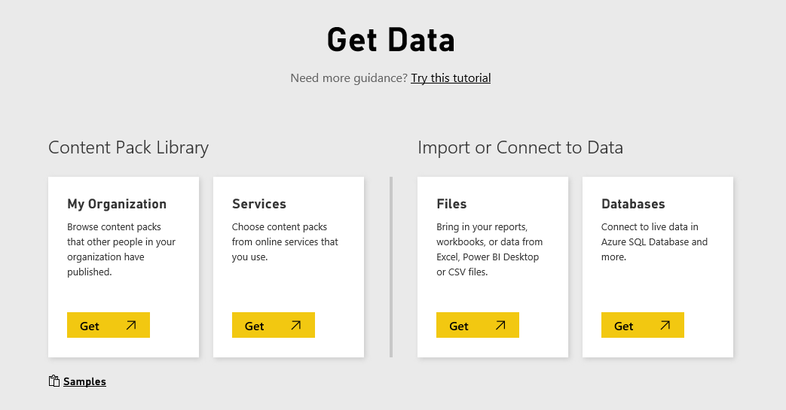
Built-in connectivity for all your data
SaaS solutions
e.g. Marketo, Salesforce, Quickbooks, Google Analytics
On-premises Data
Organizational Corporate data sources or external data services
Azure services
Azure SQL, Stream Analytics…
Excel and CSV files
Power BI Desktop files
Data from files, databases, Azure, and other sources
Notes:
Key message:
Power BI connects to a variety of data sources, enabling you to view and explore data from hybrid sources in a single location.
Talking points:
The Power BI Get Data feature lets you quickly and easily connect to all of your data.
This includes a range of both cloud sources, on premises sources and specific data files —from the SaaS solutions you already use to your organization’s on-premises data.
Many sources have been integrated with Power BI, connecting in minutes with pre-built dashboards and reports.
For the first time, you can easily get a consolidated view of your data, no matter where the data actually lives.

Slide 78
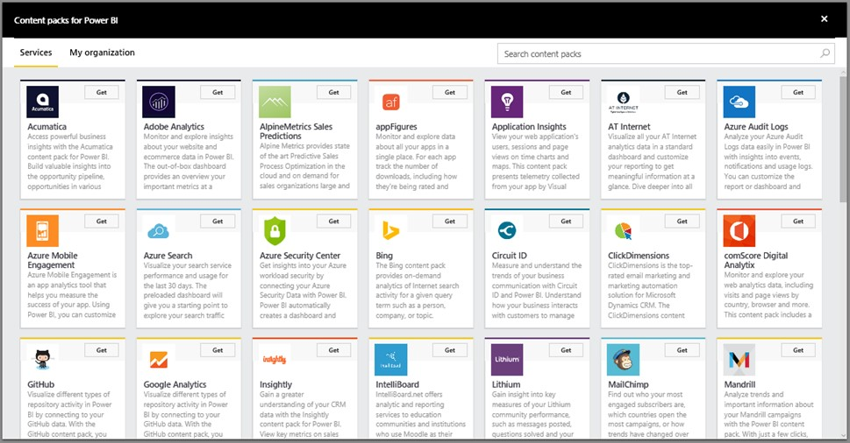
Start discovering business insights right away
Connect to cloud services you already use – popular SaaS solutions
Quickly start with solution-specific content packs, which include:
Pre-configured dashboards
Reports
Data models and queries
Explore data with fast data processing
Automatic data refresh is built-in
SaaS solutions
On-premises Data
Organizational
Azure services
Excel and CSV files
Power BI Desktop files
Notes:
Key message:
Power BI connects to the SaaS services that you already use with pre-configured dashboards, reports, and data models.
Talking points:
It’s easy to discover business insights quickly by connecting all of the SaaS data sources you already use to Power BI.
Power BI has “connector” functionality that establishes a direct connection to a variety of popular SaaS solutions.
View all of the available content packs by logging into Power BI. New content packs are added regularly.
It’s more than just a connection though – Power BI has a “content pack” for each SaaS solution.
These “content packs” consist of pre-configured dashboards, reports, data models, embedded queries and metadata.
That means users don’t have to set anything up from scratch – you connect your data and instantly have a beautiful dashboard ready for you to customize to your needs.
Thanks to the direct connection from Power BI, data processing is optimized, so you can explore at a rapid pace.
And data is updated automatically each day (or on-demand if you need it) – no need for special refresh configuration.

Slide 79
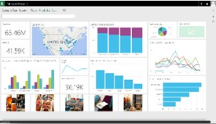
Connect live to your on-premises data
Live Power BI Dashboards and Reports
Connect directly to your existing on-premises data sources:
Analysis Services (tabular and multidimensional)
SQL Server
SAP HANA
Oracle
Teradata
PowerApps
Microsoft Flow
Azure Logic Apps
Scheduled Refresh
Manage & Monitor
Requires On-Premises Data Gateway
Cloud
On-premises
On-Premises Data Gateway
Role-based and row-level data security is applied
Data Source
Data Source
Data remains on-premises, only query is stored in Power BI
SaaS solutions
On-premises Data
Organizational
Azure services
Excel and CSV files
Power BI Desktop files
Notes:
Key message:
Connect live to your existing on-premises data, such as SQL Server Analysis Services or SQL Server. No need to move your data to the cloud.
Talking points:
Power BI lets you establish live connectivity with on-premises SQL Server Analysis Services tabular and multi-dimensional models.
Use On-Premises Data Gateway to configure the connection with your existing SSAS solution (replaces the Analysis Services Connector).
The connection is live – meaning that when users view and explore dashboards, Power BI interactively queries the on-premises cube to fetch the data right then.
This enables efficient data exploration thanks to optimized query performance.
You can create reports with SSAS data on powerbi.com, even while data remains on-premises.
Your existing, role-based SSAS permissions, still apply – user access to SSAS data via Power BI is controlled the same way.
The connection to SSAS is secured via Azure Service Bus SSL encryption.

Slide 80
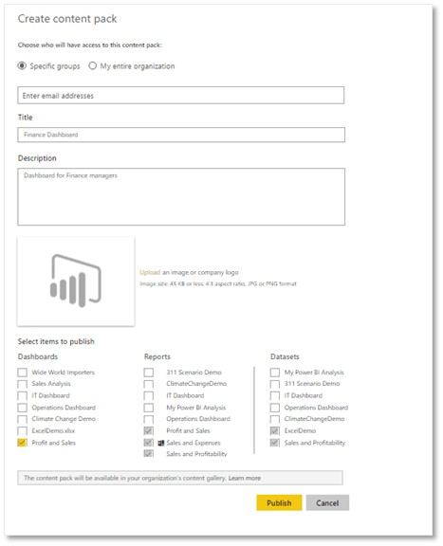
Get immediate insights into your organization
Content packs make it easier and faster for users to explore the data
Content packs include:
Pre-built dashboards
Reports
Pre-defined data models
Package up and share your own dashboard, reports, and datasets with your coworkers
SaaS solutions
On-premises Data
Organizational
Azure services
Excel and CSV files
Power BI Desktop files
Notes:
Key message:
If your organization needs to connect to a data source that isn’t yet integrated with Power BI, no problem – that’s what custom “connectors” and content packs can address.
Talking points:
Using the Power BI REST API library, developers can create custom “connectors” – i.e. codes that integrate nearly any data source with Power BI.
If you offer a data service, whether that’s a SaaS solution, industry-specific data, or some other type of service, a custom connector enables your customers to pull data into Power BI. This gives them more opportunity to use your service and realize additional value.
If you need to make data available across your organization, a custom connector can do just that in an efficient way. For example, your finance team can provide access to financial data to the appropriate users across the organization.
In addition to connecting your data source, Power BI REST APIs enable you to create and publish organizational content packs, which consist of pre-built dashboards, reports, data models, embedded queries, and metadata.
Content packs make it easier and faster for users to explore the data you’re providing – they get dashboards and reports that they can use immediately to drive insights.
With connectors and content packs, users can also use data from custom sources alongside other data, giving them an even more comprehensive picture of what they need to manage.

Slide 81





Consume structured/unstructured data with Azure services
Stream Analytics
Event Hubs
Connect directly to data from Azure services, including:
Azure SQL Database
Azure SQL Data Warehouse
Spark on HDInsight
Machine Learning
Power BI
Push live, streaming data from Azure Stream Analytics with built-in destination for Power BI for real-time dashboards at any scale
Storage
Integration with other Azure services, including Azure Machine Learning, opens up new scenarios, without writing thousands of lines of code
SQL Server
HDInsight
SaaS solutions
On-premises Data
Organizational
Azure services
Excel and CSV files
Power BI Desktop files
Notes:
Key message:
Power BI integrates with select Azure services, enabling you to build seamless end-to-end data solutions.
Talking points:
For example, Power BI integrates with SQL Database and SQL Data Warehouse, making it easier to query large data sets in real-time.
Power BI also directly integrates with Azure Stream Analytics - real-time data from Stream Analytics can be pushed directly into Power BI for real-time visibility via dashboards.
For example, if you have IoT devices like sensors and factory-floor machines connected to Stream Analytics, that data can be surfaced live to Power BI dashboards, so operations managers can get real-time information on the status of plant operations.

Slide 82
Connect to your data from files
Local file
OneDrive – Undefined
SharePoint – Team Sites
Learn about importing files
Import data into Power BI from files:
Microsoft Excel (xlxs or xlsm)
Power BI Desktop (pbix)
Comma Separated Value (csv)
Files can be located on:
Local machine
OneDrive Business or Personal
SharePoint Team Sites
Two ways to use Excel files:
Import into Power BI
Connect (or upload), manage and view in Power BI
Any changes to a file in OneDrive or SharePoint are synced automatically (hourly)
Data and reports from Power BI Desktop files
SaaS solutions
On-premises Data
Organizational
Azure services
Excel and CSV files
Power BI Desktop files
Notes:
Key message:
You can upload Excel, CSV and Power BI Desktop files from your computer, or connect to them on OneDrive for Business, OneDrive Personal or SharePoint Team Sites.
Talking points:
Where your file is saved makes a difference.
Local - If you save your file to a local drive on your computer or another location in your organization, from Power BI, you can import your file into Power BI. Your file will actually remain on your local drive, so the whole file isn’t really imported into Power BI. What really happens is a new dataset is created in your Power BI site and data, and in some cases the data model are loaded into the dataset. If your file has any reports, those will appear in your Power BI site under Reports.
OneDrive - Business – If you have OneDrive for Business and you sign into it with the same account you sign into Power BI with, this is by-far the most effective way to keep your work in Excel Power BI Desktop, or a CSV file and your dataset, reports, and dashboards in Power BI in-sync. Because both Power BI and OneDrive are in the cloud, Power BI connects to your file on OneDrive about every hour. If any changes are found, your dataset, reports, and dashboards are automatically updated in Power BI.
OneDrive - Personal – If you save your files to your own OneDrive account, you’ll get many of the same benefits as you would with OneDrive for Business. The biggest difference is when you first connect to your file (using Get Data > Files > OneDrive – Personal) you’ll need to sign in to your OneDrive with your Microsoft account, which is usually different from what you use to sign in to Power BI. When signing in with your OneDrive with your Microsoft account, be sure to select the Keep Me Signed In option. This way, Power BI will be able to connect to your file about every hour and make sure your dataset in Power BI is in-sync.
SharePoint Team-Sites – Saving your Power BI Desktop files to SharePoint – Team Sites is much the same as saving to OneDrive for Business. The biggest difference is how you connect to the file from Power BI. You can specify a URL or connect to the root folder.
Two ways to use Excel workbook in Power BI
Import - When you import, any supported data in tables and/or a data model are imported into a new dataset in Power BI. If you have any Power View sheets, those will be re-created in Power BI as reports.
You can continue editing your workbook. When your changes are saved, they’ll be synchronized with the dataset in Power BI, usually within about an hour. If you need more immediate gratification, you can just click Publish again, and your changes are exported right then and there. Any visualizations you have in reports and dashboards will be updated, too.
Choose this option if you’ve used Get & Transform data or Power Pivot to load data into a data model, or if your workbook has Power View sheets with visualizations you want to see in Power BI.
In Excel 2016, you can also use Publish > Export. It's pretty much the same thing.
Connect, manage and view Excel in Power BI - when you connect, your workbook will appear in Power BI just like it would in Excel Online. But, unlike Excel Online, you’ll have some great features to help you pin elements from your worksheets right to your dashboards.
You can’t edit your workbook in Power BI. But if you need to make some changes, you can click Edit, and then choose to edit your workbook in Excel Online or open it in Excel on your computer. Any changes you make are saved to the workbook on OneDrive.
When choosing this way, no dataset is created in Power BI. Your workbook will appear in your Power BI workspace navigation pane under Reports. Connected workbooks have a special Excel icon.
Choose this option if you only have data in worksheets, or you have ranges, PivotTables and charts you want to pin to dashboards.
In Excel 2016, you can also use Publish > Upload. It's pretty much the same thing.

Slide 83
Overview
Power BI Premium
Power BI service
Power BI data sources
Power BI Desktop / Visio integration
Summary

Slide 84

Create Power BI Content
Power BI Desktop
Companion to the Power BI Service
For Business Analysts
Rich report authoring tool with direct publish to Power BI service
Built-in data access, mashups, and transformation capabilities
Updated regularly
Connect to data and build report for Power BI
Notes:
Power BI Desktop is a visual data exploration and interactive reporting tool, providing a free-form canvas for drag and drop exploration of your data, an extensive library of interactive visualizations, and an authoring experience for ease of report creation for the Power BI service.
A freely downloadable 32/64bit desktop application optimized for use the Power BI Service
Combines the Power of Power Query, Power Pivot and Power View
Specializing in Interactive Visualization and Analysis.
Main output: Interactive Reports
Effortlessly publish interactive visual reports to users of Power BI
Updated on monthly basis
Excel 2013 is Microsoft’s premier business analyst tool – it includes rich business intelligence features (Power Query, Power Pivot, Power View, Power Map) fully integrated with the powerful ad hoc analysis capabilities and familiar features of Excel – like Pivot Tables and Excel Charting. With Excel 2013, analysts can publish Excel Workbooks to Power BI, sharing data, analysis and reports with users of Power BI.
For customers who don’t have access to Excel 2013, the new Power BI Desktop can be used to import and model data, then author and publish Power BI Reports to the Power BI service. While lacking the rich analytical features of Excel, it does provide a simple solution expressly designed for Power BI content creation.

Slide 85

Prepare, explore, report, and collaborate with Power BI Desktop
Acquire and prepare data with extensive query capabilities
Establish data structure and transform and analyze data
Explore data in new ways through a freeform, drag-and-drop canvas
Run R scripts directly in Power BI Desktop
Author reports with a broad range of modern data visualizations
Prepare
Explore
Report
Share and Collaborate
Notes:
1) Data preparation…. Get data, then transform and model
2) Exploration: Free form data exploration, canvas experience.
3) Report … Create interactive reports
4) Share and collaborate with Power BI
Power BI Desktop is a free desktop companion application for the Power BI service. It enables visual data exploration and report-authoring. Complementary to Excel, it combines the capabilities of Power Query, Power Pivot & Power View into a single interface.
With Power BI Desktop, you can:
Acquire and prepare data using extensive query capabilities
Manipulation and consolidation of multiple data sources is performed in Power BI Desktop – this enables Power BI service users to use data from multiple sources in a single report
Establish data structure, then transform and analyze data
Visualize and explore your data in new ways through a freeform drag-and-drop canvas
Author reports with a broad range of modern data visualizations
Publish beautiful, interactive reports directly to powerbi.com
Securely share reports through unique, curated content library approach

Slide 86
Consolidate data from a broad range of sources
Data sources available in Power BI Desktop
Use Query functionality to connect to variety of data sources beyond those in powerbi.com
File | Database | Azure | Online Services |  | Other | Other
CSV Excel JSON SharePoint Folder Text XML | Access Amazon Redshift DirectQuery for SQL Server IBM DB2 IBM Informix Impala MySQL Oracle PostgreSQL SAP Business Warehouse SAP HANA Snowflake SQL Server SQL Server Analysis Services Sybase Teradata | Blob Storage Data Lake Store DirectQuery for SQL Database DocumentDB HDInsight HDInsight Spark Marketplace SQL Database SQL Data Warehouse Table Storage | appFigures Azure Enterprise comScore Digital Analytics Dynamics 365 for Financials Dynamics CRM Online Exchange Online Facebook GitHub Google Analytics MailChimp Marketo Mixpanel Planview Enterprise ProjectPlace QuickBooks Online Salesforce | SharePoint Online Smartsheet Spark SparkPost SQL Sentry Stripe SweetIQ Troux Twilio tyGraph Webtrends Zendesk |  | Active Directory Blank Query Hadoop File (HDFS) Microsoft Exchange OData Feed ODBC OLEDB R Script SharePoint List Web
Navigate data quickly with in-memory processing that optimizes performance
Pare down datasets to only what’s needed by editing queries before data loading
Automatically find related tables when connecting to database sources
Prepare
Explore
Report
Share and Collaborate
Notes:
Key message:
Power BI Desktop allows you to connect to data sources beyond what powerbi.com supports – constantly working and adding new data sources
For more information visit: https://powerbi.microsoft.com/en-us/documentation/powerbi-desktop-data-sources/
Talking points:
The four major categories of data source are files, databases, Azure services and other (SaaS category was removed)
Power BI Desktop supports a number of data sources that other competing services do not
Navigate data quickly with in-memory processing that optimizes performance
Pare down datasets to only what’s needed by editing queries before data is loaded to Power BI Desktop
Additional SAP connectivity details are in the Appendix slides

Slide 87
Data Connectivity Modes in Power BI Desktop
 | Import | DirectQuery | Live/Exploration
Overview | ETL Data download | Select specific tables No data download Queries triggered from Report visuals | Explore source objects from Report surface No data download Queries triggered from Report visuals
Supported Data Sources | All sources (>60 sources) | SQL Server Azure SQL Database Azure SQL Data Warehouse SAP HANA Oracle Teradata | SQL Server Analysis Services (Tabular & Multidimensional)
Max # of data sources per report | Unlimited | One | One
Data Transformations | All transformations (100’s) | Partial support (varies by data source) | None
Mashup Capabilities | Merge (Joins) Append (Union) Parameterized queries | Merge (Joins) Append (Union) | None
Modeling Capabilities | Relationships Calculated Columns & Tables Measures Hierarchies | Calculated Columns Measures Change Column Types | None
With Power BI Desktop, you can connect to your data in three ways:
Import
DirectQuery
Live/Exploration
Prepare
Explore
Report
Share and Collaborate
Notes:
Power BI Desktop enables extensive data analysis, enabling you to produce rich data models using formulas and relationships
DirectQuery data sources – user can specify DirectQuery vs. Import mode in data source dialogs
Automatically create a model simply by importing data
Power BI Desktop detects relationships automatically, categorizes data and applies default summarization
Refine models to enable complex calculations
Identify relationships between datasets from a variety of sources
Create relationships between tables manually or using the AutoDetect feature
Desktop’s AutoDetect feature accelerates your analysis
Adjust relationship type (one-to-one, many-to-many or many-to-one) and cross-filter data for specific insights
Define calculations – known as measures – to generate new fields for use in reports. Measures create new information from existing data already in your model
Measures are used in some of the most common data analysis; for example, sums, averages, minimum or maximum values, counts, or more advanced calculations you create yourself using a DAX formula.
The calculated results of measures are always changing in response to your interaction with your reports, allowing for fast and dynamic ad-hoc data exploration
You can use automatically generated measures, or create custom measures with Data Analysis Expressions (DAX) formulas
This helps you enrich your data model
Produce exactly the results you need using the DAX library of 200+ formula elements
Use DAX library to create calculated tables too…
Use DAX time intelligence functions with the built-in time intelligence functions
Develop advanced analytics using a combination of measures and relationships
Uncover correlations, highlight exceptions and understand business outcomes

Slide 88
Shape data into the format and structure you need
Common data-shaping tasks
Remove rows
Rename/Remove tables and columns
Change a data type
Delete Relationships
Pivot columns and group rows
Modify a table name
Identify and fix errors
Merge or append queries to combine data from multiple queries into a single query
Extract week day, month name, hour from date/time values
Transform data to fit your needs using intuitive UI
Select data for inclusion
Cleanse data and remove errors
Precisely tune the query step sequence: re-order, add, edit or delete steps as needed
Modify data types to support specific calculation requirements
Very powerful for advanced scenarios such as Mashups
Run R scripts
Prepare
Explore
Report
Share and Collaborate
Shape and combine data
Notes:
Prepare and explore data intuitively, using functionality similar to that of Power Query for Excel
Adjust, or shape, data into the form and format that fits your needs
A few examples – you can adjust data type, remove columns, change table names and delete relationships
Use the Applied Steps view in Query Settings to precisely tune how the data is shaped - e.g. adjust the order of data-shaping steps, or remove steps if needed
Power Query records your sequence of data exploration activities, making it easy to re-apply them to additional sets of data
Manage queries easily or reorder queries via drag and drop
Use parameters in your queries that can be referenced later in the UX. Define allowed values for parameters.
Modify data types to support specific calculation requirements – some calculations require data in a specific format
Combine data from different types of data sources to ensure consistent query semantics
Add conditional columns
Built-in transformation to extract the WeekDay or Month names from a given Date/Time column. Similarly, you can extract the Start or End of an Hour based on a Date/Time or Time column.
Mashup data across multiple data sources into a single table to support advanced analysis and reporting
You can take advantage of R inside the Query Editor to perform data cleansing, advanced data shaping, and analytics in datasets including completion of missing data, predictions, and clustering, just to name a few.

Slide 89


Produce rich data models using formulas and relationships
Automatically create a model by importing data
Relationships are detected automatically, data is categorized and default summarization applied
Create relationships via drag & drop between tables
Refine models to enable complex calculations
Use automatically generated measures, create custom measures, or create Calculated Tables with Data Analysis Expressions (DAX) formulas
High-performance, in-memory engine
Secure your data at the row level by defining security filters for Roles or in the model
Prepare
Explore
Report
Share and Collaborate
DAX Function Reference
Notes:
Power BI Desktop enables extensive data analysis, enabling you to produce rich data models using formulas and relationships
Automatically create a model simply by importing data
Power BI Desktop detects relationships automatically, categorizes data and applies default summarization
Refine models to enable complex calculations
Identify relationships between datasets from a variety of sources
Create relationships between tables manually or using the AutoDetect feature
Desktop’s AutoDetect feature accelerates your analysis
Adjust relationship type (one-to-one, many-to-many or many-to-one) and cross-filter data for specific insights
Define calculations – known as measures – to generate new fields for use in reports. Measures create new information from existing data already in your model
Measures are used in some of the most common data analysis; for example, sums, averages, minimum or maximum values, counts, or more advanced calculations you create yourself using a DAX formula.
The calculated results of measures are always changing in response to your interaction with your reports, allowing for fast and dynamic ad-hoc data exploration
You can use automatically generated measures, or create custom measures with Data Analysis Expressions (DAX) formulas
This helps you enrich your data model
Produce exactly the results you need using the DAX library of 200+ formula elements
Use DAX library to create calculated tables too…
Develop advanced analytics using a combination of measures and relationships
Uncover correlations, highlight exceptions and understand business outcomes
Define synonyms for improved Q&A experience in Power BI service
Power BI row-level security allows you to secure your data at the row level by defining security filters for Roles or in a table in the model. You can define a Role and an associated security filter in the Power BI desktop and then assign members to that Role in the service. Once you have defined security filters for roles, you can test them in action by viewing the data as a specific Role in either the Power BI Desktop or the Power BI Service.

Slide 90

Explore your data with freeform, drag and drop canvas
Explore data in a variety of ways and across multiple visualizations
Pivot and slice data
Drill into and across datasets
Date sort and filters including min, max
Quick calc functions
Change visualization types
Use built-in analytical functions: group, bin, top n, include/exclude, forecast, …
Select, transform and mashup data via freeform, drag-and-drop canvas
Filter data and use cross-filters
Run R scripts and use R-powered visuals
Prepare
Explore
Report
Share and Collaborate
Notes:
The reporting step is where the visual data exploration enabled by Power BI Desktop really comes to life
Note: you can move directly from connecting to (importing) data to reporting – data preparation, modeling, and analysis are optional intermediate steps. Because Power BI Desktop automatically creates a data model for you upon data import, you can immediate generate reports
Explore data in a variety of ways and across multiple visualizations
Select data elements and sort data
Filter data and use cross-filter capabilities
Drill into and across datasets, with support for inline hierarchies
Pivot and slice data
Power BI Desktop enables you to visualize data in a number of ways and easily author reports
Depict data in compelling reports that tell stories using a range of interactive visualization
Use data from different sources in a single, consolidated report – create relationships between different data sources to create a data model, that you can then use in a report
R-powered custom visuals
Use report gridlines and snap to grid for layout
Mobile report layout
Show trend lines
Display record set for visualization
Tables: Use conditional table formatting and built-in table styles
Maps: Shape Map visual supports use of custom maps (TopoJSON format), use ArcGIS Maps
Use date slicers
Format maps
You can select, transform and mashup data via a freeform, drag-and-drop canvas
Explore data in a variety of ways and across multiple visualizations
Select data elements and sort data
Filter data, leveraging cross-filter capability
Drill into and across datasets
Pivot and slice data
Change visualization types
Use built-in analytics options for grouping, binning, top N filter, include/exclude data points
Show trend lines
Use forecasting
Display record set for visualization
Tables: Use conditional table formatting and built-in table styles
Maps: Shape Map visual supports use of custom maps (TopoJSON format), use ArcGIS Maps
Use date slicers
Use Quick Calc functions, e.g. to calculate and show the percent of the grand total for each data value.

Slide 91


Deliver valuable insights with customizable visual reports
Depict data in compelling reports that tell stories using a range of interactive visualizations
Use data from many sources in a single, consolidated report
Ability to incorporate custom visualizations
Integrate R scripts and R-powered visuals
Create layouts specific for your mobile device
Build reports with KPI trends
Change color, format and customize visualizations
Linear or Logarithmic scales in Y-axis
Customizable tooltips
Prepare
Explore
Report
Share and Collaborate
Notes:
The reporting step is where the visual data exploration enabled by Power BI Desktop really comes to life
Note: you can move directly from connecting to (importing) data to reporting – data preparation, modeling, and analysis are optional intermediate steps. Because Power BI Desktop automatically creates a data model for you upon data import, you can immediate generate reports
Power BI Desktop enables you to visualize data in a number of ways and easily author reports
Depict data in compelling reports that tell stories using a range of interactive visualization
Use data from different sources in a single, consolidated report – create relationships between different data sources to create a data model, that you can then use in a report
Use R-powered custom visuals, with your own R IDE
Use report gridlines and snap to grid for layout
Mobile report layout
Show trend lines
Display record set for visualization
Tables: Use conditional table formatting and built-in table styles
Maps: Shape Map visual supports use of custom maps (TopoJSON format), use ArcGIS Maps
Use date slicers
Format maps
You can select, transform and mashup data via a freeform, drag-and-drop canvas
Explore data in a variety of ways and across multiple visualizations
Select data elements and sort data
Filter data, leveraging cross-filter capability
Drill into and across datasets
Pivot and slice data
Change visualization types
Use built-in analytics options for grouping, binning, top N filter, include/exclude data points
Show trend lines
Use forecasting functions
Display record set for visualization
Tables: Use conditional table formatting and built-in table styles
Maps: Shape Map visual supports use of custom maps (TopoJSON format), use ArcGIS Maps
Use date slicers
Customize tooltips – add more context and detail for the end user

Slide 92


Share reports, visualizations and data with a broad audience
Save Power BI Desktop report files and easily publish them to Power BI
Share as appropriate with other Power BI users in your organization
Copy table, cells or columns to clipboard
Use Power BI template (.pbit file) to save and share the definition of a report, data model and queries, not actual data
Prepare
Explore
Report
Share and Collaborate
Notes:
Once you are ready to publish your report and the visualizations within it, you can surface it to a broader audience by publishing to the Power BI service
Save the Power BI Desktop file, then go into the Get Data interface on powerbi.com to upload the report and share it with others
This enables you to give Power BI users access to richer data models and reports than they could create on their own
If you’re not ready to move your PBIX reports and data to the cloud, but you want to share analytics content across the enterprise, giving Power BI Desktop users the ability to publish PBIX files to an on-premise or private cloud server, you can use the “Publish to Pyramid Server” functionality.

Slide 93






IT capabilities
Whitelisting
Full auditing capabilities
Capacity admin can allow specific users to use capacity when needed.
Office 365 admin can access audit logs that capture information about Premium capacities.
Capacity admin grants access
Pro user w/permissions
increase capacity
Office 365 admin can review change in audit log
Dedicated
Shared
Dedicated
HR Workspace
Finance Workspace
Sales Workspace
Sales Workspace

Slide 94
Visio integration

Slide 95
Monitoring: Unified Dashboards
Operational Intelligence
Real-world Context
Interconnections
Sequence
Real world Visualization
See the full picture with Unified Dashboards
KPI
Analysis
Goal
Business Intelligence

Slide 96

Process metrics – Cost / Elapsed Time / Status
1.0K
Notes:
Change designs and mockups to investigating – done.

Slide 97

Process metrics seen visually
Designs and mockups
1.0K
Notes:
Change designs and mockups to investigating – done.

Slide 98



Retail Store Inventory management

Slide 99



Inventory management done visually
Notes:
[Done] Add legend. And make the greens full with stock

Slide 100


Slide 101


Slide 102


Slide 103


Slide 104


Slide 105


Slide 106






5 Steps to Powerful Unified Dashboards
1
2
3
4
5
Create Visio Diagrams
Import to Power BI
Map Power BI Data to Visio Shapes
Define Interaction with Data and Shapes
Share the Dashboard
Notes:
Presetup before the demo: remove the custom visual from this https://aka.ms/visiopbi-facility
Step 1 - Diagram:
https://microsoft.sharepoint.com/teams/VisioTeamsite-LBI/_layouts/15/WopiFrame.aspx?sourcedoc=%7BA6B1FA41-A4B9-436D-87AC-9C615BFE0BD7%7D&file=Floor%20Plan%202.vsdx&action=default
Step 2 - Import to power BI
Open report https://aka.ms/visiopbi-facility
Import the visio visual https://visuals.azureedge.net/msit/visioVisualDF-CDN.pbiviz
Click on Visio visual and expand it to a good size
Expand people assignment and select room number and add that to ID column
In the input URL place https://microsoft.sharepoint.com/teams/VisioTeamsite-LBI/_layouts/15/WopiFrame.aspx?sourcedoc=%7BA6B1FA41-A4B9-436D-87AC-9C615BFE0BD7%7D&file=Floor%20Plan%202.vsdx&action=default
Step 3 - Map Power BI Data to Visio Shapes
Now open the mapping pane and expand the room number
Now click on un mapped room and then click on pbi row to map them.
Step 4 - Define Interation with data and shapes
Now add deviation to values and choose colors if not already
Make the changes to colors
Now showcase the auto-zoom and 2-way interaction.
Step 5 - Share the dashboard
Click on pin live page and mention the give it a name and open the dashboard.
Click on share button.
\\officestore\scratch\visio\pbi\demo\MSDIS\Authoring video.mp4
A similar report has been created here for your reference
https://msit.powerbi.com/groups/11b39096-bef3-4d9d-82cc-f23936e3796d/reports/78d46d54-9bfe-498f-8328-d656a1c7e8e9/ReportSection

Slide 107
Demo

Slide 108
Visio for PowerBi Support
Support Now:
Get rich visuals in Power BI.
Easily connect with Power BI data.
Visualize Power BI data in colors and text graphics.
Publish to Web support (with file having anonymous access).
Coming soon:
Support for Power BI Desktop
Support for Power BI Mobile
Support for Email subscription and publish to PowerPoint
More visualization graphics.

Slide 109






Call to Action
@msvisio @msftvisio
Sign up to try at: aka.ms/visio-new
Tell us at:
tellvisio@microsoft.com

Slide 110
Overview
Power BI Premium
Power BI service
Power BI data sources
Power BI Desktop / Visio integration
Summary

Slide 111
It’s easy to get started…
PowerBI.com
Notes:
Key points
Go to Powerbi.com to get started.
Learn more about Power BI Premium from the Powerbi.com site
Internal to Microsoft. You can go to aka.ms/BI and access documentation and presentations both internal and customer facing.
TALK TRACK
If you want to learn more about Power BI Premium, simply go to the Power site to learn more.
Then, for internal users, the place to go for slide decks and content demos is aka.ms/BI.

Slide 112
Links
https://github.com/powerbi
https://powerbi.microsoft.com/en-us/
https://mva.microsoft.com/training-topics/business-intelligence#!lang=1033
https://mva.microsoft.com/product-training/power-bi#!prodv=Power%20BI%20for%20Office%20365&lang=1033
https://support.office.com/article/4f09be62-f436-45c2-93b0-4a0f66b1f5a7

Slide 113
HOL scenario
HOL 1:
Install PowerBI Desktop from: https://powerbi.microsoft.com
Follow: https://powerbi.microsoft.com/en-us/documentation/powerbi-desktop-getting-started/?wt.mc_id=mkto_EM297201A1LA1&ls=email&m
HOL2: Open and check the „ContosoAnalyticsDashboard“

